Slide 1

CHINS (Children in Need of Services) & Diversion Task Force Update
April 10, 2026, Lynn Flieth|

Slide 2


Youth exhibiting negative behaviors that are NOT criminal in nature; commonly referred to as “status offenses”. Previously termed “Unruly” in ND Century Code, with referrals going to the Juvenile Court
CHINS behaviors, as defined in NDCC 27-20.3:
Using/possessing tobacco and related products (vaping) age 10-14.
Truancy: 3 or more days, unexcused.
Running away from home/residence
Disobeying lawful and reasonable commands of parent/guardian; “ungovernable”

Slide 3

Goals & Roles of CHINS
To Engage, Empower and Educate Parents/ Caregivers to be actively involved in their children’s lives and activities.
To focus on connecting youth and family to community supports and resources earlier, preventing deep systems involvement.
“Navigator” role vs. service provider
Dual Status Youth Liaisons; facilitating coordination between Human Service Zones and Juvenile Courts for youth with multi-systems involvement.
The primary goal is to focus on prevention, treatment and support to divert youth from further entering the juvenile justice or child welfare systems.
Discontinue treating non-criminal behavior in a criminal justice model.
Research indicates that a “light touch” and service connection for youth lead to more positive outcomes and less likelihood to appear in the adult criminal justice system.
Voluntary participation

Slide 4

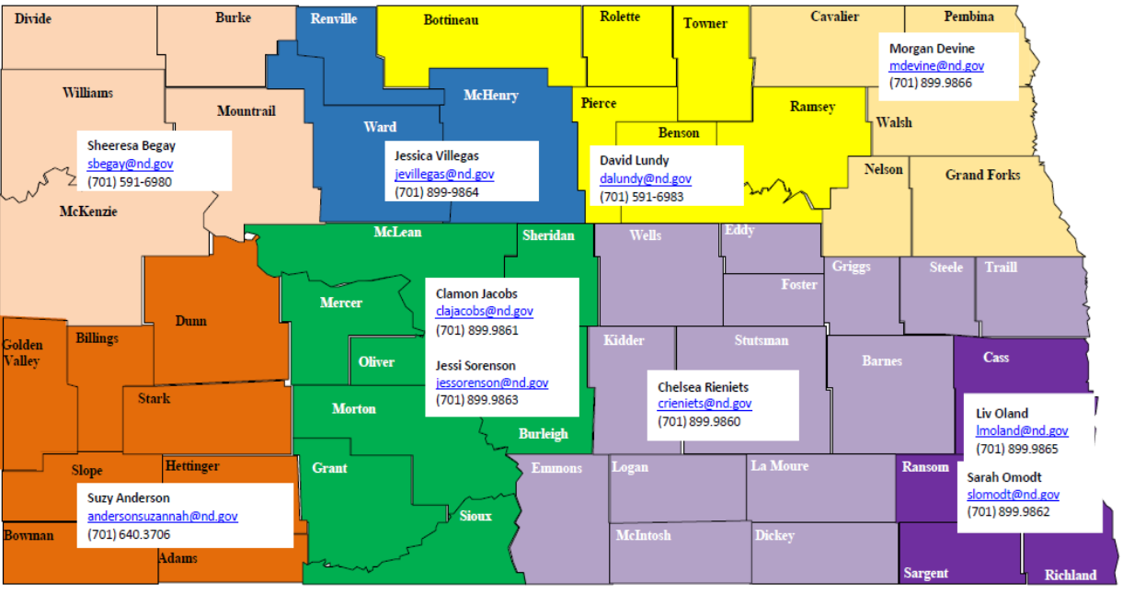
Statewide Unit of 10
9 full time Specialists and 1 Supervisor
Employed by RSR Human Service Zone
Administrative support from Cass Human Service Zone
Central referral inbox: CHINS@nd.gov

Slide 5

HB 1012 Section 16 Division Task Force and Funding
SECTION 16. JUVENILE JUSTICE DIVERSION SERVICES AND PROGRAMS - TASK FORCE - REPORT.
Section 1 of this Act includes the sum of $750,000 of one-time funding from the human services finance fund for juvenile justice diversion services and programs. The department of health and human services must use the funding for services to youth at risk of juvenile justice involvement but who have not committed delinquent acts as defined in chapter 27-20.4.
The department shall establish a task force with representation from divisions in the department, human service zones, the department of public instruction, elementary and secondary schools, and members of the legislative assembly, to review juvenile justice diversion services and program. The department shall report its findings and recommendations to the legislative management and children's cabinet
5
Notes:
Intake 22,000 calls
18000 full reports
Foster 1480 current in FC
subsidy payments for almost 1,900 children per month.

Slide 6

Diversion Task Force Members
Randy Lamberth – Bismarck Schools
Lisa Jahner –Juvenile Justice State Advisory Group, NDACO
Samantha Pulvermacher – North Star Human Service Zone
Sheeresa Begay -CHINS worker
Senator Diane Larson – District 30
Representative David Richter – District 1
Representative Alisa Mitskog – District 25
Kevin Hoherz - NDCEL
Kami Myles – Grand Forks Human Service Zone
Genelle Olson - CREA
Dave Steckler – Grand Forks Public Schools
Jason Schwabe Thompson Public Schools
David Wisthoff – Bismarck Public Schools
Scott Fau – Minot Public Schools
Jennifer Withers -DPI
Sean Anderson – Juvenile Court Director, Unit 4
Lynn Flieth - RSR Human Service Zone Director
Laren Sauer – Children Family Services/HHS

Slide 7
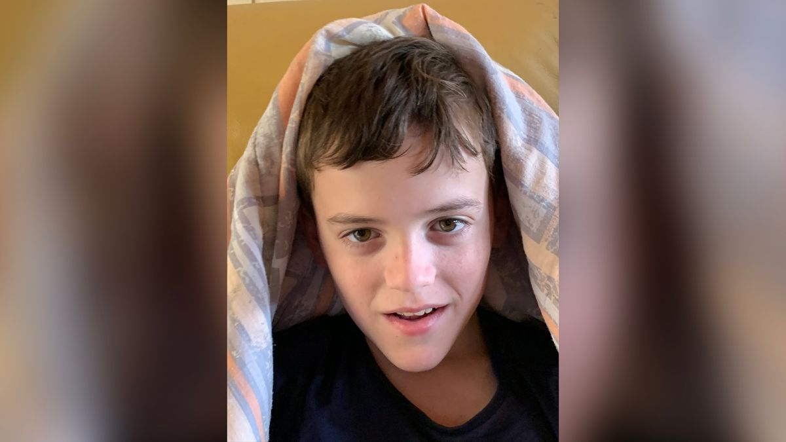


Diversion Task Force Topics & presentations—to date
Final Juvenile Justice Commission Report—Lisa Bjergaard
Overview of Diversion Services funding/budgeting and grantees
Family First Prevention Services—Tracy Miller
Juvenile Justice State Advisory Group—Lisa Jahner
Youth & Family Services, ND Behavioral Health Clinics—Dr. Cramer
1915i Services– Cody Stanley
Youthworks, Diversion Service grantee– Alicia Brown
Survey of School Administrators/identified gaps & barriers; NDCEL—Kevin Hoherz
Family Resource Hub pilot & technical assistance grant to JJSAG– Lisa Jahner

Slide 8
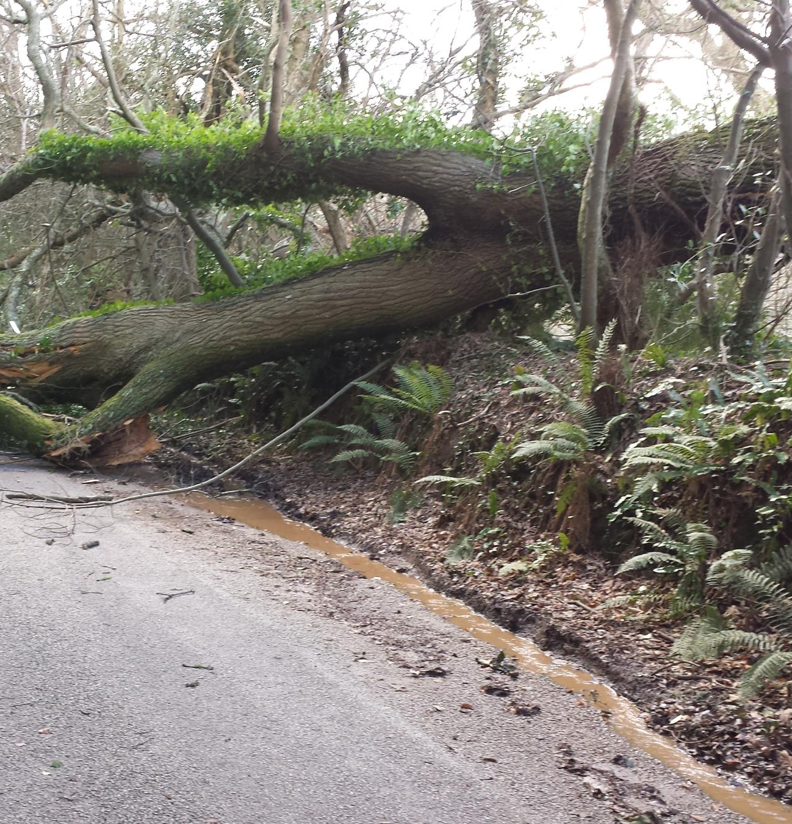
Barriers
Service availability and navigation; having the right service, at the right time, in the right place.
Communication; misinformation, misunderstandings, variances in application of law and/or policy.
Systems change fatigue and frustration-who does what?
Current restrictions on Diversion Service eligibility limiting service provision.
Challenges presented by outlier situations
Need for standardized reporting and tracking
Notes:
Barriers to achieving sustainable change

Slide 9

Next Steps
Identifying and finalizing the priorities and recommendations of the Diversion Task Force. Some ideas include:
Items we can resolve today (ex: reporting form to juvenile court)
Maximizing educational opportunities across systems (courts, schools, CHINS, law enforcement/SRO’s) to enhance communication and relationships.
Update eligibility criteria for “Diversion Services” next session to expand services to youth.
Regional Service mapping (example Region8)
Survey task force members for consensus/agreement
What else?

Slide 10

Diversion Task Force Co-Chairs
Lynn Flieth
RSR Human Service Zone
lflieth@nd.gov
Lauren Sauer
Children and Family Services; HHS
lsauer@nd.gov
10

