Slide 1


School Readiness
Early Childhood Subcommittee
April 2026

Slide 2
Comprehensive Literacy State Development (CLSD)
Birth – grade 12
ND has received three SEA level grants over 2017-present
Competitive federal discretionary grant
Requirement to partner with early childhood education entity in the state
Focused on oral language and literacy growth & development

Slide 3

Where we've been
During SRCL "On the 5's" document was created and distributed
Was a collaborative DPI project – led by Specially Designed Services team
In 2024, work began on a refresh & update of this project to improve the focus on literacy

Slide 4


North Dakota Legendary Learners
Legendary Family Learning: Building Literacy Skills
This guide has three sections:
  Storybook: "I Can Do That! Theo is Ready for School"
  Scrapbook
  Parent Guide: Cracking the Code to Reading
This initiative was created with room for growth into other academic areas

Slide 5
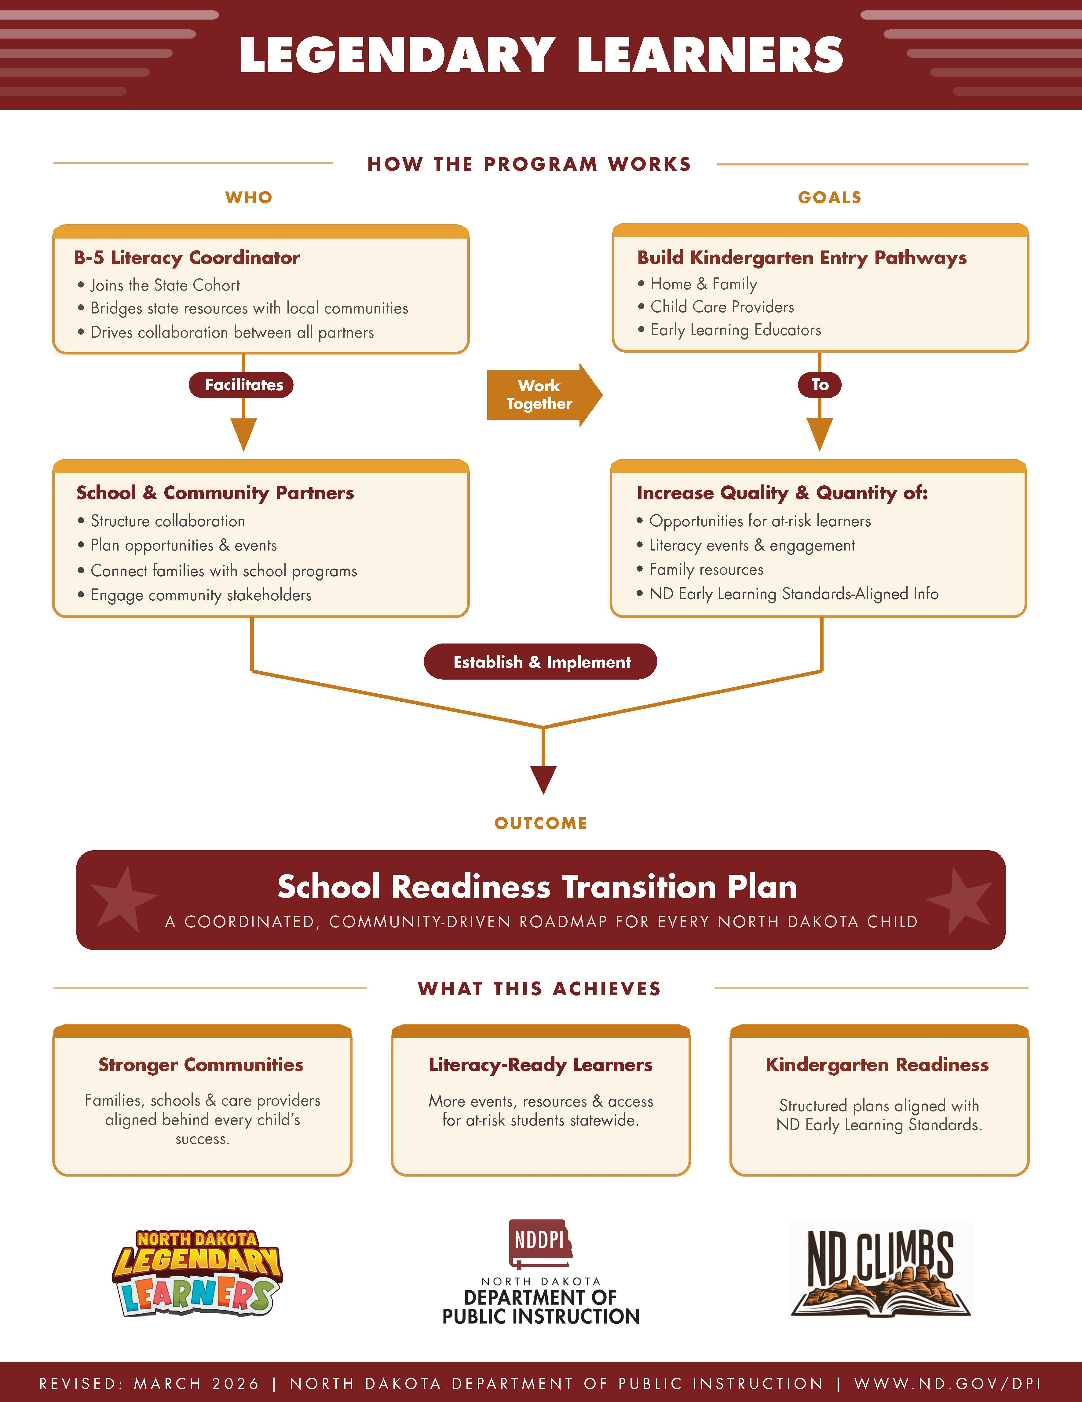
What the grant looks like now
The Legendary Learners grant program is part of the birth to five effort the the SEA's CLSD (2024) grant.
Awarded to elementary buildings
Communtiy effort led by a designated coordinator
Coordinator's network facilitated by a contracted provider
  Sterling Literacy
Schools and communities will work together to create a School Readiness Transition Plan that will have roles & expectations that live beyond the grant cycle

Slide 6
Preschool Development Grant Birth to Five
Our PDG renewal grant application included supporting smooth transitions and alignment of services for children and families across early childhood, kindergarten and the early grades.
ND received a planning grant in 2018 and a renewal grant in 2022
Maximizing Parent and Family Engagement in the B-5 System was one of five required components each state had to address in the application.
Notes:
Administration for Children and Families at the US Department of Health and Human Services jointly with the U.S. Department of Education solicited applications for Preschool Development Grant Birth - Five. ND was awarded $2.6M for the planning grant and $20M for renewal.
Our Part B and Part C teams worked closely together to develop new guides and training for professionals and parents to support transitions for early intervention and early childhood special education which includes policies and procedures. We also included mini grants to LEA’s around transition from pre-K to kindergarten.

Slide 7

Kindergarten Sturdy Bridge
Improving transitions into kindergarten and from kindergarten into first grade
2023-2024 U.S. Department of Education national community of practice for state leaders in early childhood and K-12 systems.
Kindergarten Sturdy Bridge ND Members
Janelle Wiedrich, HHS, Early Childhood Lead
Kate Waechter, DPI, Academic Support
Kay Larson, HHS Early Childhood Director
Carolyn Kueber, Head Start Collaboration
Angela McSweyn, Part B, 619
Atiana Beck, English Language, DPI
Angie Richter, Title 1, DPI
Shonda Wild, HHS Best In Class
Jill Olson, Principal, Grafton Public Schools
Dr. Kelli Odden, Mayville State University
Michelle Zaun, Parent/Family member
Notes:
Superintendent Baesler asked us to apply for a Kindergarten Sturdy Bridge opportunity. ND was accepted and part of a Kindergarten Sturdy Bridge Learning Community, a multi-state collaborative effort focused on strengthening the transition from early childhood settings into kindergarten and the early elementary grades. The initiative emphasized creating developmentally appropriate, aligned systems so children experience continuity in learning and relationships as they enter formal schooling.

Slide 8
Local LEA studies and pilots sturdy bridge strategies
Sturdy Bridge Framework
Cross-sector kindergarten transition teams
Professional development for educators
Family engagement practices
Alignment of curriculum from early childhood into elementary grades
Social connect opportunities for children and families
Communication system between early learning providers and schools
Data informed decision making
The state team worked closely with:
Grafton Public Schools – In addition to participating in the state team, Jill Olson, principal at Grafton Public School, developed a local team that participated in their own national community of practice with other LEAs. Her team was able to focus on transition into both kindergarten and the early grades.
Mandan Little Leaners – Mandan Public invited the state team to visit and joined the state team for a site visit to Grafton for shared learning and together we identified challenges and successes as well as strategies that could be scaled across the state.
Notes:
Each Kindergarten Sturdy Bridget team included a local education agency which in turn had to develop a local team to study and pilot sturdy bridge strategies. So, Jill participated in the state team community of practice and along with her local team they participated in a community of practice specific to the LEA partners from each state team.

Slide 9
Kindergarten Transition Survey of ND School Districts
In January 2025, a survey went out to districts asking them about kindergarten transitions. We received 105 responses.
Are you currently implementing any sort of on-site kindergarten transition program beyond a one-time round-up or open-house event?
61 yes
44 no
What resources, program or approach do you use?
Gearing Up for Kindergarten 23
Jump Start 4
District created 28
Other, please describe –most said offer preschool

Slide 10

Kindergarten Transition Grants
Preschool Development Grant B-5 renewal funds were used to support LEAs in development kindergarten transition plans.
Bismarck
Central Valley
Divide County – Crosby
Garrison
Grafton
Griggs County
Jamestown
May-Port
Oakes
Parshall
Wahpeton
West Fargo-Westside
Notes:
We aligned Sturdy Bridge learning with our goal of supporting smooth transitions with planning tools and technical assistance for school districts developing comprehensive kindergarten transition plans. This included mini-grants and a resource to help cross sector teams in planning.
We supported twelve school districts with one-time grants of up to $10,000 to design and implement local kindergarten transition plans that support children and families in the year prior to kindergarten entry.
These funds allowed districts to develop community-specific transition strategies, including professional development for educators, family engagement activities, collaboration with early childhood partners, and the creation of welcoming transition experiences that help children feel prepared for school. Data collection is underway.

Slide 11
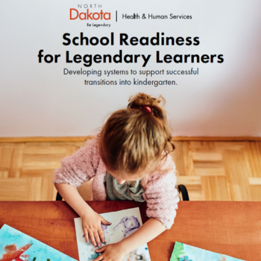
School Readiness for Legendary Learners
Developing Systems to Support Successful Transition into Kindergarten
A collaborative approach to school readiness recognizes that children, families, schools, programs, peers and community are all interconnected and have important roles to play throughout the process.
This guide is meant to help cross sector teams establish purposeful goals around four connections that can improve partnerships, relationships, experiences, and most importantly outcomes for legendary learners.
Program – school connections
Child – school connections
Family – school connections
Community – school connections
Notes:
This is the planning tool that was created to support local collaborations between early childhood programs, school districts, community partners, and service agencies to improve school readiness outcomes for children and families.
This guide is ADA compliant. Both print-ready and digital versions were created by Agency MABU, the same vendor that created the Legendary Learners book. 1000 copies have been printed. Project total $23,400.
The digital version was shared with the Kindergarten Transition Grant community of practice. Additional distribution plans include distributing copies to the head start grantees, presenting at a western REA event and the Back-to-School drill down this fall. Placed on

Slide 12
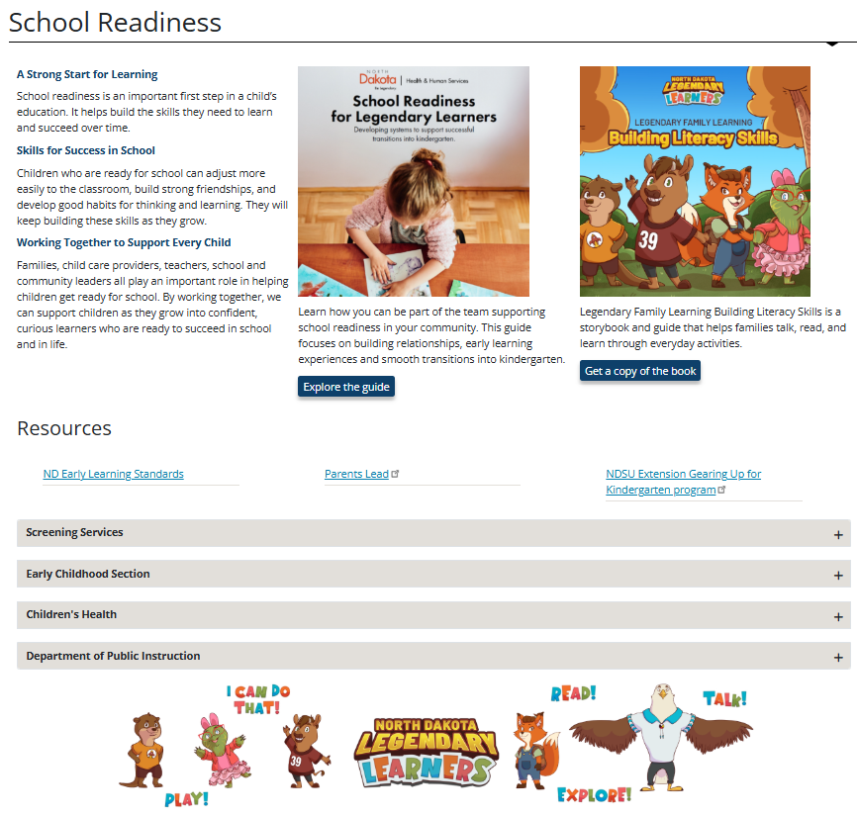
HHS Landing Page
https://www.hhs.nd.gov/cfs/early-childhood-services/familyandschoolengagement/school-readiness
Notes:
In addition to the guide, this webpage was created to store resources and information to help prepare early learners for school. Currently this this page is only publicized through a QR code in the school readiness guide.
There are lots of options –
We can update the QR code to point to a new webpage with the content so those with the QR code still have access to the resources
We could provide broader access to the webpage. The Children’s Cabinet could announce the launch of HHS’s new School Readiness webpage as resources for early childhood programs, school districts, community partners, and service agencies as well as families to support successful transitions to school.
There is opportunity for growth -Additional tools and resources could added to this page or this page could point to another with more information and resources

Slide 13

Podcast series on parenting in the early years
This new podcast series talks about the real stuff- messy, funny, frustrating, and heart-filled moments that make parenting what it really is.
Episodes include:
Protecting the Growing Brain: Love, Limits, and Everyday Prevention
Navigating Big Feelings with Little Kids
Building Resilience Through Play
Small Routines, Big Resilience: Real-Life Tools for the Early Years
Healthy Habits for Healthy Minds: Screens, Sleep, and Winter Routines
Notes:
PDG funding $242,000 was used to develop early childhood content for Parents Lead. One of the deliverables included the development of a podcast series, the first episodes were live in late 2025

Slide 14
Training Incentives
Although not incentivized, school readiness trainings may be available on the statewide training calendar from a variety of training sponsors.
Examples from IACET accredited training sponsors:
Roadmapping Preschool Curriculum – 3 clock hours
Overview: awareness of knowledge and skills children need by the time they go to kindergarten to plan curricula for preschoolers
Sponsor: ChildCare Ed
Kindergarten Readiness – What it Really Looks Like - 2 clock hours
Overview: outline of standards and how to prepare your students for kindergarten readiness
Sponsor: AIR Training Solutions
Training incentives help cover the costs of high priority training and coursework leading to an early childhood credential or degree.
Incentive Eligible Trainings and Coursework:
E-Pyramid Model modules
Seeds of Learning 3-5’s
Language Essentials for Teachers of Reading and Spelling (LETRS) for Early Childhood
Early childhood credit-bearing coursework
Notes:
There are a number of high priority trainings that support school readiness.
State general fund – executive base budget - $300 for completion of eligible training;

Slide 15
Pyramid Model (PM)
Dr. Kelli Odden, Higher Ed
Janet Bassingthwaite, Early Childhood Community Dev.
Nicole Reybok; Special ed unit director
Katie Houle; HHS Behavioral Health
Jessi Hegg; Head Start Director
Missi Baranko; USpireND
Jordan Anderson; HHS Part C
Carolyn Kueber; HHS Head Start Collaboration Officer
Carol Johnson; HHS Part C consultant
Kristen Votava; HHS Part C consultant
Allison Driessen; Head Start Director
Kim Hruby; HHS Healthy and Safe Communities
Kelli Ulberg; HHS Behavioral Health
Shonda Wild; HHS Best in Class Admin
Jennifer Prince; HHS PD and Workforce Admin
Rachel Tabler: NDDPI Educational Improvement and Support
Jodi Webb, ND Pathfinders
Jackie Adusumilli, HHS Part C
Kate Rogers – contracted consultant
A National Pyramid Model Consortium consultant worked with a ND state team to consider PM implementation fidelity and the supports and infrastructure needed to ensure implementation can occur within the classrooms and services provided to children and their families across ND.
HHS also contacted with MaSU/Dr. Kelli Odden to develop a PM coaching guide and community of practices for ND PM coaches. Additionally, Dr. Odden facilitated a series of challenging behavior webinars that included resources to support implementation of evidence-based practices along with children’s literature and professional development books.
Notes:
PDG funds to contract with national Pyramid Model consortium over 2 years $50,000
MaSU $264,000

Slide 16
Early Intervention
REIL Grant and PDG funds supported practitioner development
Using the framework to help early intervention professionals partner with families to build nurturing relationships, create supportive home environments, and respond to each child’s unique needs
Head Start
Regional Head Start grant
Mayville State using the framework in head start, child care, and four-year-old programs
Best in Class
PDG funding
Each coach is supporting one classroom in implementation of Pyramid Model
Child Care
PDG and State funding
Each inclusion coach is supporting one program (director and at least two staff at each program) in implementation of Pyramid Model
Pyramid Model is a multi-tiered, evidence-based framework designed to promote social competence and lessen challenging behavior in young children. Children who can self-regulate, build relationships, and express emotions are better equipped for learning.

Slide 17
We’re here to support school readiness initiatives in a collaborative capacity
We’d be happy to:
Help think through next steps
Point you to relevant resources
Connect you with subject matter experts
Entertain a rebrand of ready-made resources

Slide 18

Contact Info:
Taylor Olsen
NDDPI Education Program Administrator
tlolsen@nd.gov
Kay Larson
HHS Early Childhood Director
kaylarson@nd.gov

