Slide 1

Children’s Behavioral Health in North Dakota
Behavioral Health Division

Slide 2
Agenda
Definition of children with significant behavioral/psychiatric needs
Continuum of care across systems overview:
  Specific services provided
  Challenges
  Service Gaps
What Success Looks Like

Slide 3
Definition of Serious Emotional Disturbance
21 years of age or younger
Have a behavioral health condition that is expected to last a year or longer.
At least moderate functional impairment:
  WHODAS 25+; or
  DLA-20 score of <5
*With CCBHC adoption…, will expand to serve/support all those with BH need.

Slide 4
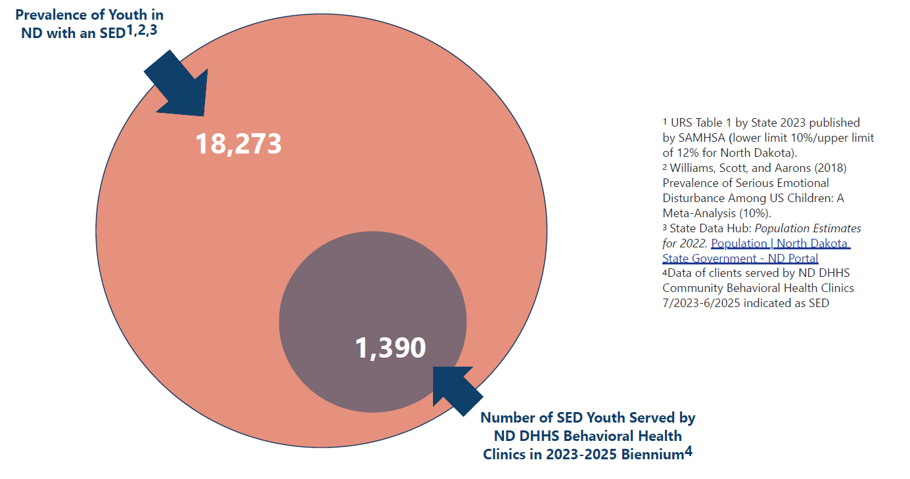

Slide 5
Youth Continuum of Care – Clinics (Current State)
Care Coordination & Crisis Services can span the continuum
Crisis Services can be used at any level of care and are available 24/7 (988, mobile crisis, Avel e-care, Solutions)
Prevention/Early Intervention
Intensive Home and Community-Based
Partial Hospitalization
Psychiatric Residential Treatment Facility
Outpatient
Inpatient/ Acute Hospitalization
Community Education
Therapy (individual/group)
Medication Management
Case management
Rehabilitative Services
May take place:
In-home
In-office
Takes place in-home or in-community
Typically more than one outpatient service
Team functions as a unit to assist more complex needs (ex: *FFT, *MST)
20 hours of care per week
Takes place in a setting attached to a hospital
Overseen by a Psychiatrist
A non-hospital, inpatient setting that provides comprehensive mental health treatment
Intensive, 24-hour therapeutic care in a structured environment
Purpose is to stabilize, build skills, and transition back to community
For individuals at risk of acute or imminent risk of harm to self or others due to mental health
Short-term
Focused on crisis resolution and connection to services
Available all clinics
Clinic Provided – Single Location
Not Provided by Clinics – Statewide Available
Other specialty services: Competency Assessment and Remediation; Psychological Testing; Applied Behavioral Analysis
*FFT- Functional Family Therapy (evidence-based modality for team-based care for youth with complex behavioral health needs and their families)
*MST- Multi-Systemic Therapy (evidence-based modality for team-based care for youth with complex behavioral health needs and their families)

Slide 6
Care Coordination
12 Care Coordinators have been hired to date at the Behavioral Health Clinics
  1 NW, 1 NC, 1 LR, 1 NE, 3 SE, 1 SC, 1 WC, 3 BL
Supports families in accessing the right behavioral health services at the right time
Connects youth and families to providers, resources, and supports across systems (health, education, social services, etc.)
Reduces gaps in care by coordinating communication between providers and systems
Ensures continuity of care during transitions
Improves outcomes by creating a unified, team-based approach around the youth and family

Slide 7
Behavioral Health Clinics
2023-2025 Biennium

Slide 8
Behavioral Health Clinics
* Ages 0-17
7/1/2023-6/30/2025

Slide 9
Behavioral Health Clinics
Functional Family Therapy Services
Region | # Individuals Served | Cases Completed
NW | 20 | 3
NC | 5 | 0
NE | 3 | 0
SE | 4 | 3
SC | 19 | 6
WC | 43 | 7
BL | 25 | 11
Total | 119 | 30
Implementation of Functional Family Therapy Services
September 2023: Consultation to Implement Functional Family Therapy
February 2024: 20 FTE Approved to Hire
August 2024: Statewide Training
Current Status: Available in 6 out of 8 regions
  11 out of 20 positions filled as of 6/1/2025
  Lake Region actively hiring
  Southeast following Multisystemic Therapy Service Model
August 2024 - June 2025

Slide 10
RMAC Clinical Services
2023-2025 Biennium
Data indicates the primary diagnostic profile of the youth admitted to RMAC within the last biennium consist of four core areas, often intersecting in complexity:
  Conduct and Behavior Challenges
  Trauma
  Developmental/Neurodivergence
  Complex Psychiatric
Partnership between RMAC and LSTC to include Applied Behavioral Analysis (ABA) services as a core clinical service
Shift from traditional talk therapy towards evidence-based approaches
Enhanced clinical metrics

Slide 11
RMAC Quality Improvement
2023-2025 Biennium
During the fiscal year 2023-2025, a strategic plan was developed to analyze data available, community needs, and the state needs for youth. A summary of the strategic goals are listed below:
  Align RMAC with the evidence-based practice models, serving youth who are the most complex and highest need in the state of North Dakota to increase services close to their home community and decrease out of state placements and serve as safety net.
  Provide the structure, staffing patterns, training, and compensation necessary to recruit and retain qualified staff at all levels
  Enhance the facility operations to decrease barriers to internal and external stakeholders benefiting from the RMAC program
Notes:
2020 Dr Schield
The changes started prior to July 2021, with pressure for RMAC to change programming to serve youth that were more Acute and needed a safety net.
Where other in state facilities were not accepting youth, the direction was moving RMAC into a position of serving the most complex youth in ND. Such as those denied by all other facilities. There as a group formed and starting around July 2021 meetings regularly were scheduled to update the admissions process and programming of RMAC to make this transition.
The challenge was early on very few on the team had PRTF or system of care experience…

Slide 12
RMAC Data
2023-2025 Biennium
Notes:
Data shows steady increases in total youth served, particularly in 2024-early 2025

Slide 13
Challenges and Gaps- Clinics
Crisis Services- national best practices call for youth-specific crisis services
  MST and Solutions in Fargo region currently provide youth-specific mobile crisis
  Limited behavioral health workforce a challenge
  Crisis residential for youth not currently available in ND
Outpatient Treatment:
  Currently serving those with most significant functional impairment and referring out others. Lack of community capacity to meet need.
  Workforce challenges.
  Lack of equitable access based on location
  Fee for service models are not adequate in funding services for individuals with complex needs
Difficulty in standardizing/operationalizing school-based programs based on discrepancies across districts regarding resources/philosophy.
Partial Hospitalization programs- not adequately available across regions

Slide 14
What Success will Look Like:
Early Access to Services
  Families receive timely support without waiting for a crisis to occur before services are available.
  Comprehensive early intervention and prevention programs are in place to reduce the need for higher-cost, more intensive treatment later.
  Behavioral health care is treated with the same priority and respect as physical health care, eliminating stigma and ensuring true parity in coverage and access.
Appropriate and Seamless Access to Care
  Children and families can access the right level of care based on clinical need without unnecessary barriers.
  Gaps in service availability do not force families to use higher levels of care than necessary.
  When higher levels of care are required, access processes are streamlined and family-friendly.
Services Close to Home
  Services are available within or near the communities where families live, whenever practical and clinically appropriate.
  Local access reduces disruption to family life and supports community-based care.
Services that Promote Long-Term Health and Stability
  Care is designed to strengthen the overall well-being of youth and families, reducing the intensity and frequency of treatment needs over time.
  The system supports the development of healthy, resilient youth who thrive at home, in school, and in their communities.

