Slide 1
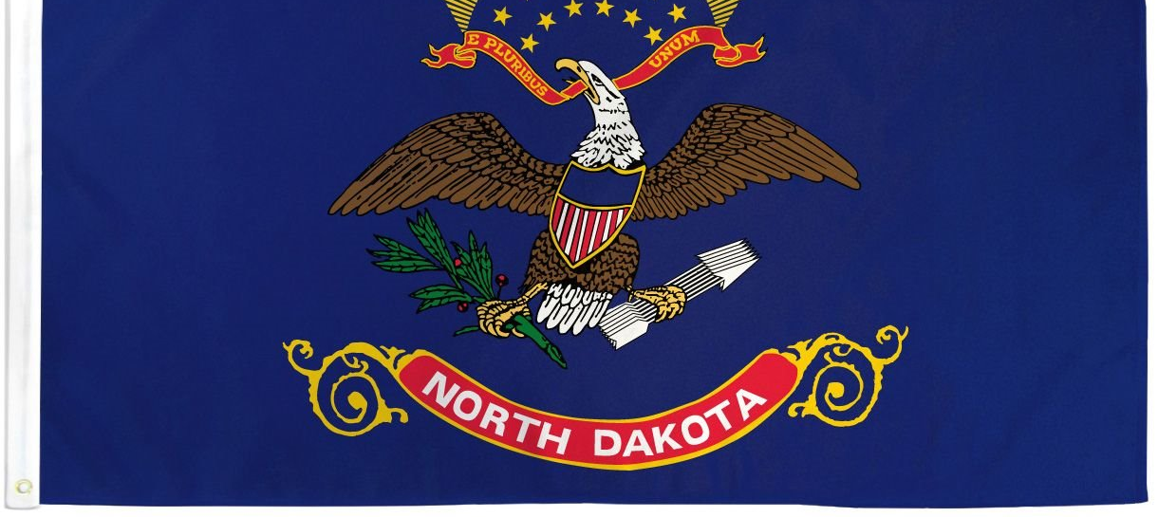
North Dakota Children’s Cabinet
Strategic Planning

Slide 2

Values, Vision, Mission
Values
360 Communication: the Children’s Cabinet will engage in open, honest and meaningful communication that leads to positive results for all children and families.
Optimism: the Children’s Cabinet will be solutions-focused, adopting a can-do attitude while avoiding the impulse to admire the problem.
Accountability: the Children’s Cabinet accepts clear accountability for leadership and allows all members to know their role and responsibility while sharing a common vision.
Vision: The North Dakota Children’s Cabinet ensures that all children are prepared and successful, equipped with the skills, knowledge, and resilience to thrive in an ever-changing world.
Mission: The North Dakota Children's Cabinet collaborates to elevate what works and drive towards a seamless network of services and supports that meet the needs of every child and family.
Defined Population: North Dakota Youth ages 0-21

Slide 3



Impact Statement & Goals
Mission: The North Dakota Children's Cabinet collaborates to elevate what works and drive towards a seamless network of services and supports that meet the needs of every child and family.
.
Goal Statements:
Goal #1: strengthen foundational elements of the North Dakota Children’s Cabinet through the development and communication of a strategic plan by Fall 2025.
Goal #2: Define, measure and report out on the status of child well-being in North Dakota by June 2026.
Goal #3:
Identify and elevate promising practices to advance a seamless network of services and supports throughout North Dakota by August 2026.
Notes:
:

Slide 4



Strategic Formation
Goal #1:
Goal #2:
Goal #3:
Initiative 1A:
Initiative 2A:
Initiative 3A:
Initiative 1B:
Initiative 2B:
Initiative 3B:
Initiative 1C:
Initiative 2C:
Initiative 3C:

Slide 5
Tactics
Goal 1.1: By September 2025, develop and approve by-laws to govern internal and external processes.
Goal 1.2: By August 2025, develop and implement a branding & communication strategy for ND Children’s Cabinet.
Goal 1.3 Establish a regular meeting schedule and a calendar of deliverables by September 2025, including the formation of at least three subcommittees tasked with deep-dive issue exploration and reporting recommendations within six months of formation.
Goal 1.4: By September 2025, define and document the Cabinet’s population focus to include children (ages 0–21), families with children, and youth in key transition stages, and build a feedback loop with ecosystem stakeholders, including youth, through at least four listening sessions annually.
Activity #1:
Draft a version of by-laws.
R --SP
A--CC
C
I
Timeline
Activity #2:
Approve by-laws
R--SP
A--CC
C
I
Timeline
Activity #1: Identify the purpose of a comms plan.
R--SP
A--CC
C
I
Timeline
Activity #2: Develop a project plan for the development of a comms plan.
R-SP
A--CC
C
I
Timeline
Activity #3
Build the Comms plan
--desired outcomes
--audience
--budget
--medium/cadence
R--SP
A--CC
C
I
Timeline
Activity #4
Publish the plan
Activity #1
Establish Calendar of meetings to include deliverables
R--SP
A--CC
C
I
Timeline
Activity #2
Form 3 subcommittees to include Areas of Responsibility
R--SP
A
C
I
Timeline
Activity #3
Identify Key actions for each strategic goal
R—SP, EC, 1556
A--CC
C
I
Timeline
Activity #1
Define age range & key transitions
R
A--CC
C
I
Timeline
Activity #2
Identify stakeholder groups representative of entire youth ecosystem
R
A
C
I
Timeline
Activity #3
Curate existing data and youth state/national reports
R
A
C
I
Timeline
Activity #4
Conduct listening sessions with stakeholders, SME, ,and PWLE to include youth.
Goal #1: strengthen foundational elements of the North Dakota Children’s Cabinet through the development and communication of a strategic plan by Fall 2025.
Metrics:
Outputs:
By-laws; elevator pitch; comms plan; Meeting schedule & deliverables;
Notes:
Activities:
Add operations plan/charter​
Elevator pitch to ensure common voice when speaking externally​
Legislator outreach and education​
Listening sessions
Gain youth buy-in in problem identification and solution building.
Create communication strategy for dissemination of Children’s Cabinet initiatives
Enlist thought partners and create feedback loop among youth ecosystem stakeholders.
Define focus of Children’s Cabinet to “children” ages 0-21; families with children; youth in key transition stages.
Curate repository of reports from state children-serving agencies (one-stop shop of resources)
Consult with: subject-matter experts, people with lived experience and industry leaders.

Slide 6

Goal 1.1: By October 2025, develop and approve by-laws to govern internal and external processes.
R—Strategic Subcommittee
A—Children’s Cabinet
C—CC, AG, ?
I—?

Slide 7
Goal 1.1: By October 2025, develop and approve by-laws to govern internal and external processes.
ND Strategic Planning Sub-committee dates*
Tuesday, September 2nd—Introduce draft of CC By-Laws
Tuesday, October 7—Make recommendation for By-Law approval.
ND Children's Cabinet Meeting Dates
Tuesday, September 16—Introduce draft of CC By-Lawsdlkajfad
Tuesday, October 21—Approval of CC By-Laws

Slide 8
Proposed By-laws
North Dakota By-laws Draft
Intended purpose: Provide a clear, nimble, shared agreement regarding the why, what, when, who and how we operate as a children’s cabinet without being overtly bureaucratic.
What is the Children’s Cabinet
Our Purpose (Why)
Who’s on the Cabinet
How We Work?
Accountability
Public Engagement
Our Work Areas (by statute)
Leadership
Working Groups—what is their charge?
Amending the By-Laws
Goal 1.1 By Laws

Slide 9
Impact Statement & Goals
Mission: The North Dakota Children's Cabinet collaborates to elevate what works and drive towards a seamless network of services and supports that meet the needs of every child and family.
.
Goal Statements:
Goal #1: strengthen foundational elements of the North Dakota Children’s Cabinet through the development and communication of a strategic plan by Fall 2025.
Goal #2: Define, measure and report out on the status of child well-being in North Dakota by June 2026.
Goal #3:
Identify and elevate promising practices to advance a seamless network of services and supports throughout North Dakota by August 2026.
Notes:
:

Slide 10
Tactics
Planning and Initiation (Sept – Oct 2025) Goal 2.1: By October 2025, Set foundation, finalize project structure, and begin stakeholder identification.
Definition & Stakeholder Engagement (Nov – Jan 2026) Goal 2.2: By January 2026 Build consensus on terminology, definition of well-being, and collect feedback.
Data Mapping & Framework Development (Feb – April 2026) Goal 2.3: By April 2026 Identify key indicators and data sources; refine definition and glossary.
Framework Validation and Metric Selection (May – June 2026)Goal 2.4: By June 2026, validate approach with partners, refine metrics, identify long-term data needs.
Finalization and Launch Preparation (July – Aug 2026) Goal 2.5: By August 2026, Finalize the strategic plan and prepare for public launch and implementation planning.
Goal #2: Define, measure and report out on the status of child well-being in North Dakota by August 2026.
Activity #1
R
A
C
I
Timeline
Activity #2
R
A
C
I
Timeline
Activity #3
R
A
C
I
Timeline
Activity #1
R
A
C
I
Timeline
Activity #2
R
A
C
I
Timeline
Activity #3
R
A
C
I
Timeline
Activity #1
R
A
C
I
Timeline
Activity #2
R
A
C
I
Timeline
Activity #3
R
A
C
I
Timeline
Activity #1
R
A
C
I
Timeline
Activity #2
R
A
C
I
Timeline
Activity #3
R
A
C
I
Timeline
Activity #1
R
A
C
I
Timeline
Activity #2
R
A
C
I
Timeline
Activity #3
R
A
C
I
Timeline
Metrics:
Notes:
Activities:
Define child well-being: what are we measuring against? What is the % change we hope to see.
Develop reporting structure and infrastructure to house and report data

Slide 11
Implementation Timeline: Year 1
Goal | Q1 Jul – Sep 2025 | Q2 Oct – Dec 2025 | Q3 Jan – Mar 2026 | Q4 Apr – Jun 2026
Goal #1:
Goal #2:
Goal #3:
Initiative 1.1
Initiative 1.2
Initiative 1.3
Initiative 1.4
Initiative 2.1
Initiative 2.2
Initiative 2.3
Initiative 2.4
Initiative 3.1
Initiative 3.2
Initiative 3.3
Initiative 3.4

Slide 12
Implementation Timeline: Year 2
Goal | Q1 Jul – Sep 2026 | Q2 Oct – Dec 2026 | Q3 Jan – Mar 2027 | Q4 Apr – Jun 2027
Goal #1:
Goal #2:
Goal #3:
Initiative 2.5
Initiative 3.3
Initiative 3.4

Slide 13
Strategic Questions
SMART Goal 2.1 – Planning & Initiation (Sept-Oct 2025)
Establish Vision & Define Child Well-being
Vision: The North Dakota Children’s Cabinet ensures that all children are prepared and successful, equipped with the skills, knowledge, and resilience to thrive in an ever-changing world.
Does this timeline, structure and deliverables resonate with subcommittee?
What age bands do we want to consider?
What Core Domains do we want to cover?
What metrics do we currently have?
What stakeholder groups should we engage to ensure consensus?
Goal 1.1 By Laws

Slide 14
2025 Meeting Dates
ND Children's Cabinet Meeting Dates
Tuesday, August 19th
Tuesday, September 16th
Tuesday, October 21st
Tuesday, November 18th
Tuesday, December 16th
ND Strategic Planning Sub-committee dates*
Tuesday August 12th
Tuesday, September 2nd
Tuesday, October 7th
Tuesday, November 4th
Tuesday, December 2nd

Slide 15
2025 Strategic Planning Dates & Deliverables
ND Strategic Planning Sub-committee dates*
September 2nd Draft By-Laws (Goal 1) & Child Well- being Plan Discussion (Goal 2)
October 7th Finalize Recommendation for By Laws; Identify Stakeholder groups; Discuss comms & branding plan
November 4th Define Child Well-Being, Age Band, Domains, Standardize Terminology
December 2 Share out on Stakeholder engagement

Slide 16
Progress to Date
Children’s Cabinet logo​
Made amendments to statute​
Moved Children’s Cabinet to the Governor’s Office​
Created subcommittees

