Slide 1
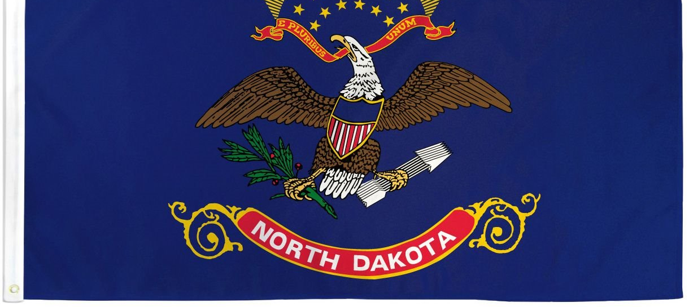
North Dakota Children’s Cabinet
Strategic Planning

Slide 2

Values, Vision, Mission
Values
360 Communication: the Children’s Cabinet will engage in open, honest and meaningful communication that leads to positive results for all children and families.
Optimism: the Children’s Cabinet will be solutions-focused, adopting a can-do attitude while avoiding the impulse to admire the problem.
Accountability: the Children’s Cabinet accepts clear accountability for leadership and allows all members to know their role and responsibility while sharing a common vision.
Vision: The North Dakota Children’s Cabinet ensures that all children are prepared and successful, equipped with the skills, knowledge, and resilience to thrive in an ever-changing world.
Mission: The North Dakota Children's Cabinet collaborates to elevate what works and drive towards a seamless network of services and supports that meet the needs of every child and family.
Defined Population: North Dakota Youth ages 0-21

Slide 3



Impact Statement & Goals
Mission: The North Dakota Children's Cabinet collaborates to elevate what works and drive towards a seamless network of services and supports that meet the needs of every child and family.
Goal Statements:
Goal #1: strengthen foundational elements of the North Dakota Children’s Cabinet through the development and communication of a strategic plan by Fall 2025.
Goal #2: Define, measure and report out on the status of child well-being in North Dakota by June 2026.
Goal #3:
Identify and elevate promising practices to advance a seamless network of services and supports throughout North Dakota by August 2026.
Notes:
:

Slide 4
Tactics
Planning and Initiation (Sept – Oct 2025) Goal 2.1: By October 2025, Set foundation, finalize project structure, and begin stakeholder identification.
Definition & Stakeholder Engagement (Nov – Jan 2026) Goal 2.2: By January 2026 Build consensus on terminology, definition of well-being, and collect feedback.
Data Mapping & Framework Development (Feb – April 2026) Goal 2.3: By April 2026 Identify key indicators and data sources; refine definition and glossary.
Framework Validation and Metric Selection (May – June 2026)Goal 2.4: By June 2026, validate approach with partners, refine metrics, identify long-term data needs.
Finalization and Launch Preparation (July – Aug 2026) Goal 2.5: By August 2026, Finalize the strategic plan and prepare for public launch and implementation planning.
Goal #2: Define, measure and report out on the status of child well-being in North Dakota by August 2026.
Activity #1
R
A
C
I
Timeline
Activity #2
R
A
C
I
Timeline
Activity #3
R
A
C
I
Timeline
Activity #1
R
A
C
I
Timeline
Activity #2
R
A
C
I
Timeline
Activity #3
R
A
C
I
Timeline
Activity #1
R
A
C
I
Timeline
Activity #2
R
A
C
I
Timeline
Activity #3
R
A
C
I
Timeline
Activity #1
R
A
C
I
Timeline
Activity #2
R
A
C
I
Timeline
Activity #3
R
A
C
I
Timeline
Activity #1
R
A
C
I
Timeline
Activity #2
R
A
C
I
Timeline
Activity #3
R
A
C
I
Timeline
Metrics:
Notes:
Activities:
Define child well-being: what are we measuring against? What is the % change we hope to see.
Develop reporting structure and infrastructure to house and report data

Slide 5
Goal 2.1: Strategic Questions
SMART Goal 2.1 – Planning & Initiation (Sept-Oct 2025)
Establish Vision & Define Child Well-being
Vision: The North Dakota Children’s Cabinet ensures that all children are prepared and successful, equipped with the skills, knowledge, and resilience to thrive in an ever-changing world.
Does this timeline, structure and deliverables resonate with subcommittee?
What age bands do we want to consider?
What Core Domains do we want to cover?
What metrics do we currently have?
What stakeholder groups should we engage to ensure consensus?

Slide 6
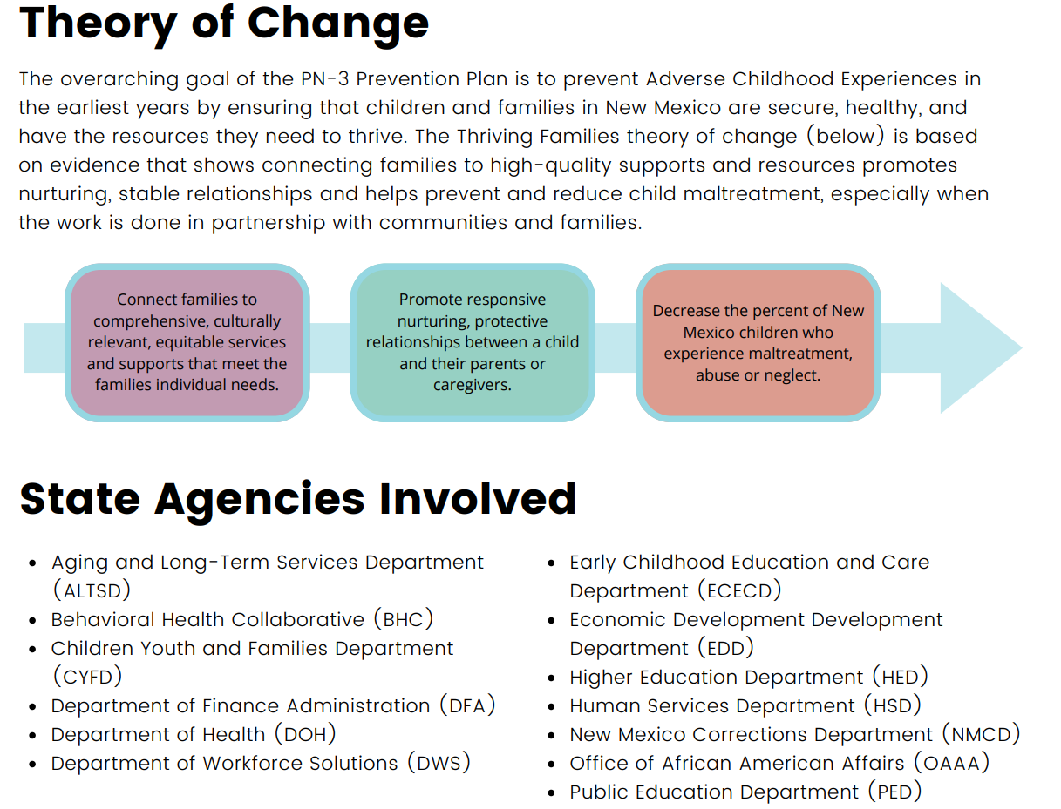
New Mexico Theory of Change

Slide 7
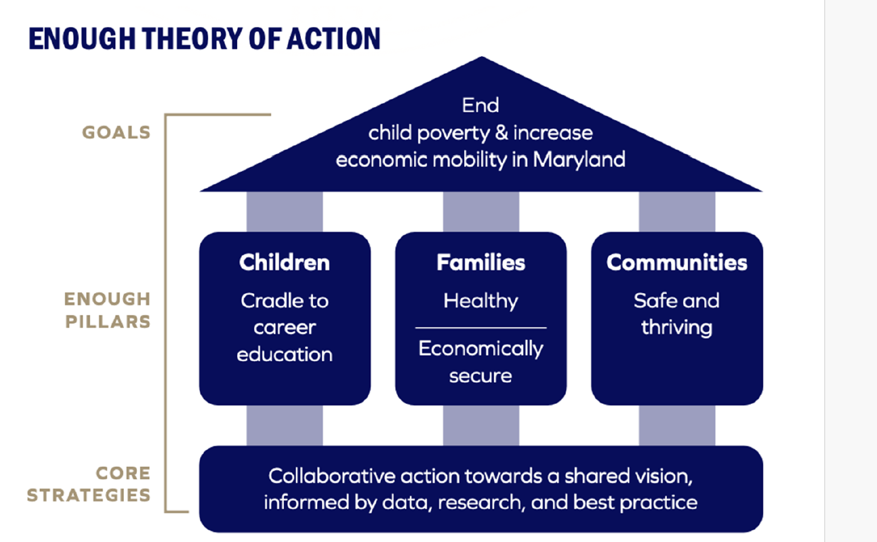
Maryland Child Well Being Theory

Slide 8
Annie E. Casey Child Well-Being
Annie E. Casey Foundation defines child well-being as a state where children are healthy, educated, and engaged in their communities. They measure this through various indicators across economic well-being, education, health, and family and community factors. The foundation emphasizes the importance of a supportive environment for children to thrive, which includes access to education, health services, and community resources. They also focus on the well-being of vulnerable children and youth, including those in single-parent families, and advocate for policies that strengthen families and communities.
Source: Child Well-Being in Single-Parent Families - The Annie E. Casey Foundation
Source: KIDS COUNT Data Center from the Annie E. Casey Foundation

Slide 9
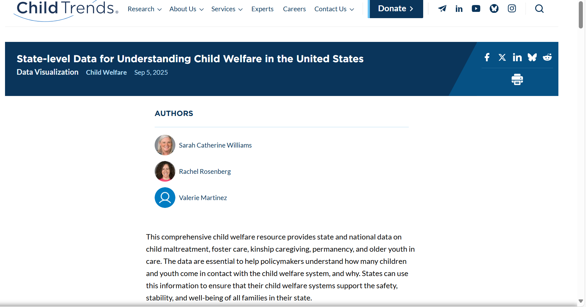
Child Trends Child Welfare

Slide 10

Indiana Graduates Prepared to Succeed

Slide 11
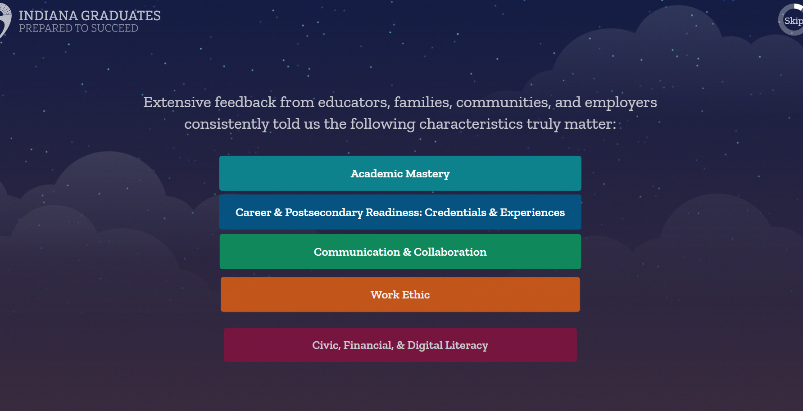
Indiana Graduates Prepared to Succeed

Slide 12
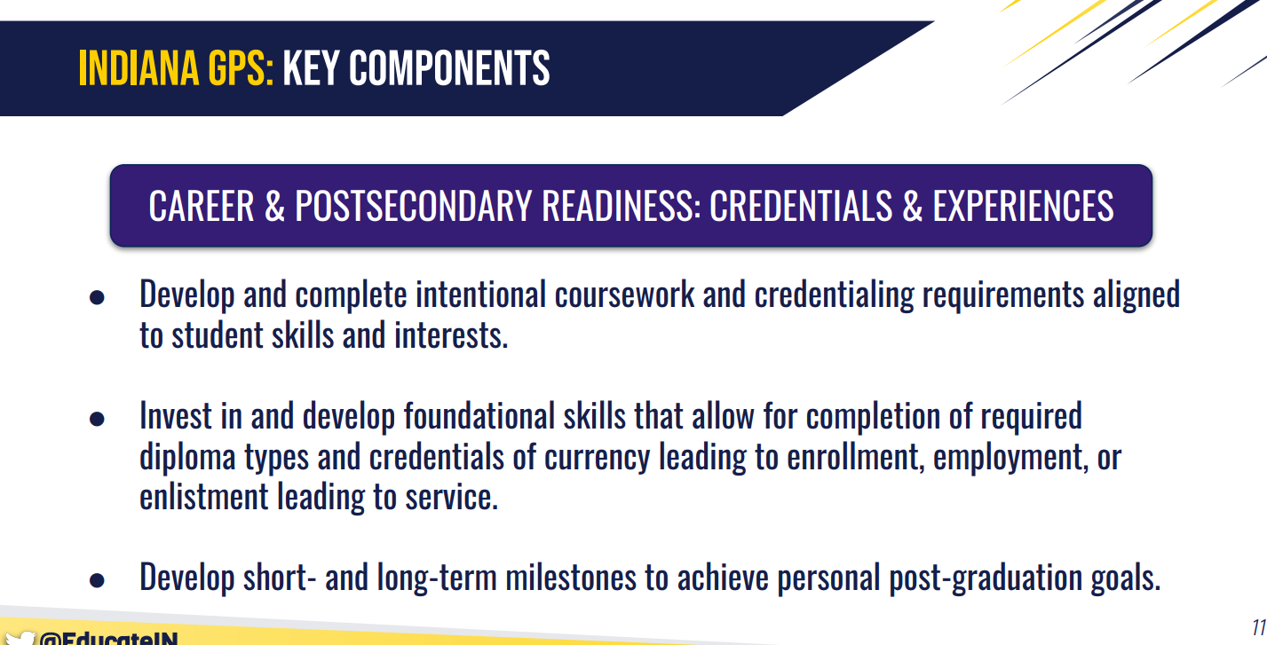
Indiana Graduates Prepared to Succeed

Slide 13
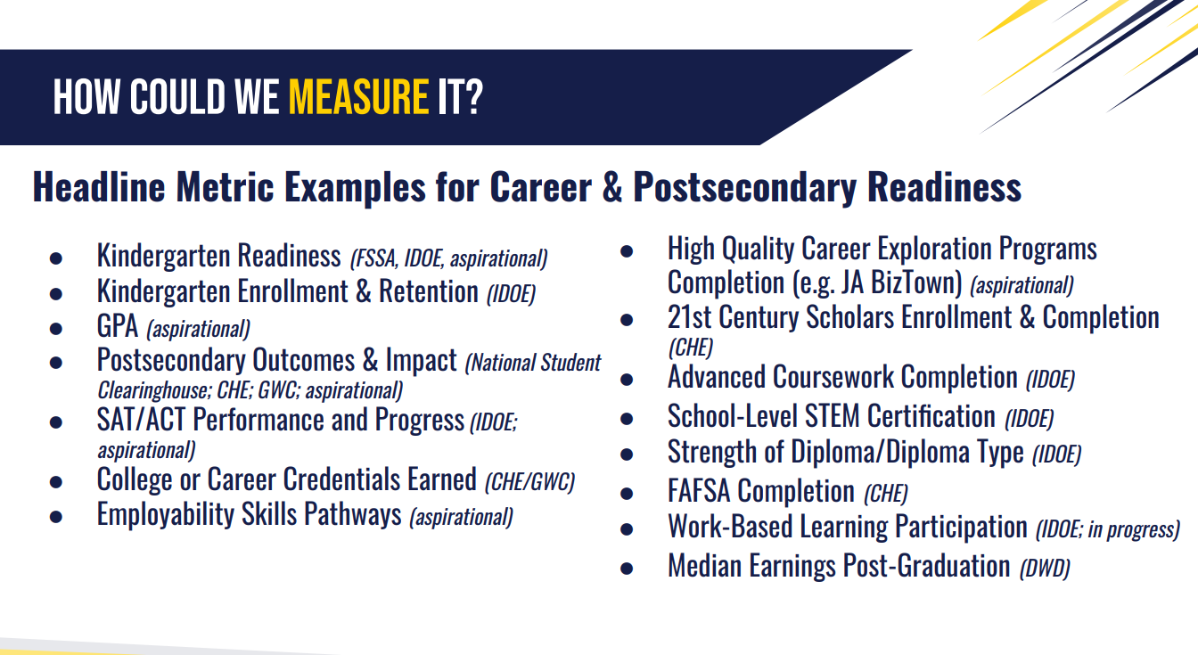
Indiana Graduates Prepared to Succeed

Slide 14
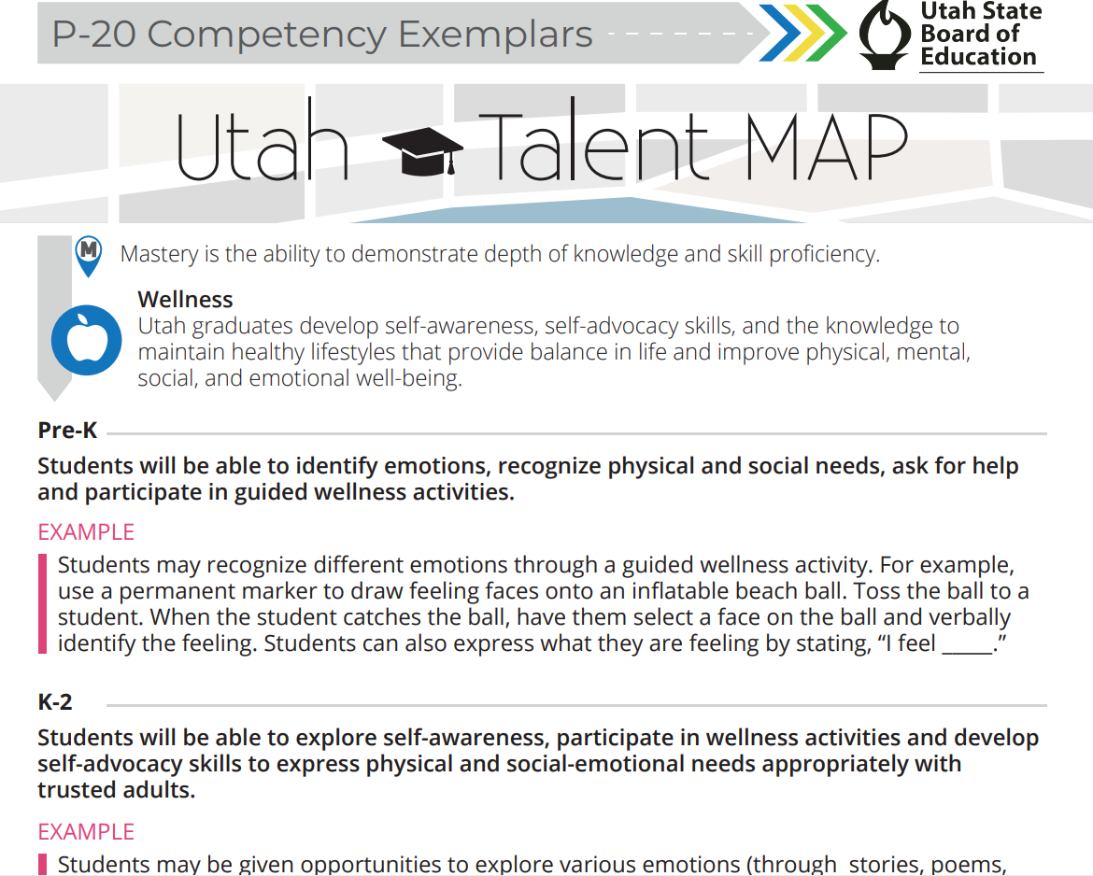
Utah Profile of a Graduate

Slide 15
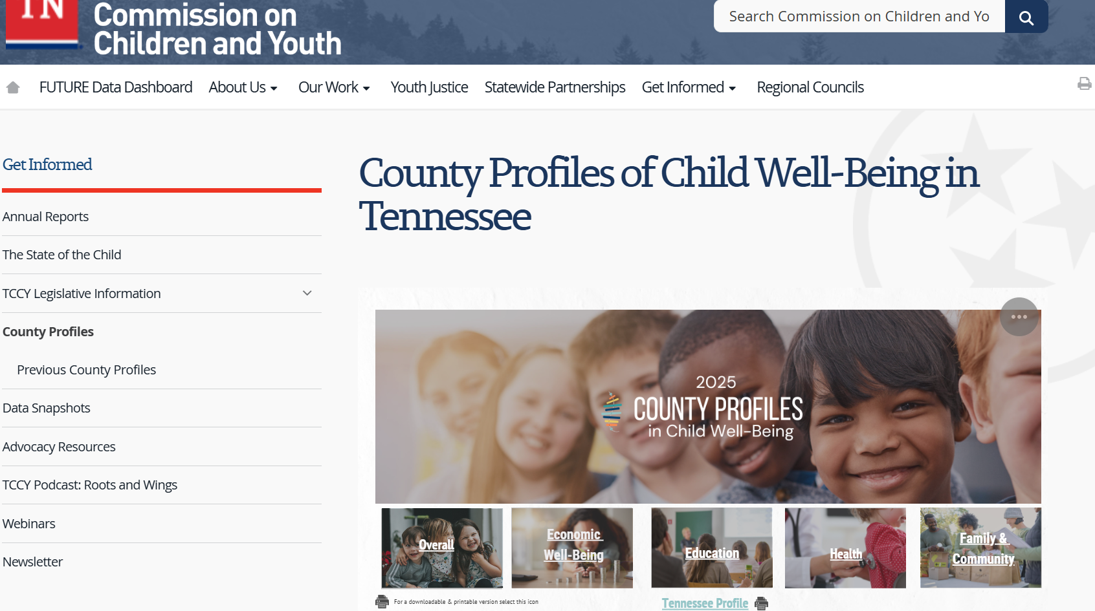
Tennessee Child Well-Being

Slide 16
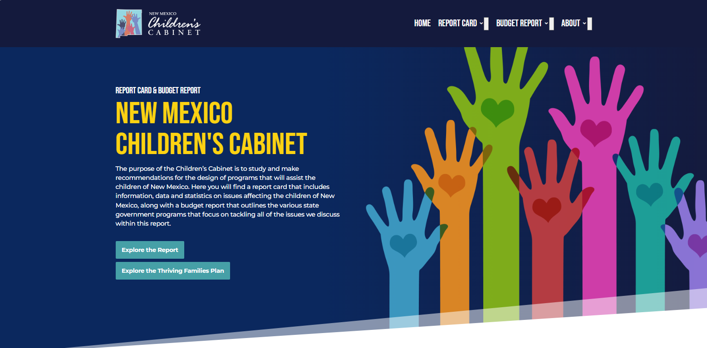
New Mexico Children’s Cabinet

Slide 17
Strategic Questions
SMART Goal 2.1 – Planning & Initiation (Sept-Oct 2025)
Establish Vision & Define Child Well-being
Vision: The North Dakota Children’s Cabinet ensures that all children are prepared and successful, equipped with the skills, knowledge, and resilience to thrive in an ever-changing world.
What defines child well-being in North Dakota?
What does preparedness and success look like?
What are the necessary skills?
What is the necessary knowledge?
How do we know if resilience is achieved?

Slide 18
Strategic Questions
SMART Goal 2.1 – Planning & Initiation (Sept-Oct 2025)
Establish Vision & Define Child Well-being
Vision: The North Dakota Children’s Cabinet ensures that all children are prepared and successful, equipped with the skills, knowledge, and resilience to thrive in an ever-changing world.
What age bands do we want to consider?
Birth-5, K-6, 7-12, post-secondary
What Core Domains do we want to cover?
Academics, Health, Economic, Family & Community, Safety
What metrics do we currently have?
What stakeholder groups should we engage to ensure consensus?

Slide 19
Implementation Timeline: Year 1
Goal | Q1 Jul – Sep 2025 | Q2 Oct – Dec 2025 | Q3 Jan – Mar 2026 | Q4 Apr – Jun 2026
Goal #1:
Goal #2:
Goal #3:
Initiative 1.1
Initiative 1.2
Initiative 1.3
Initiative 1.4
Initiative 2.1
Initiative 2.2
Initiative 2.3
Initiative 2.4
Initiative 3.1
Initiative 3.2
Initiative 3.3
Initiative 3.4

Slide 20
Implementation Timeline: Year 2
Goal | Q1 Jul – Sep 2026 | Q2 Oct – Dec 2026 | Q3 Jan – Mar 2027 | Q4 Apr – Jun 2027
Goal #1:
Goal #2:
Goal #3:
Initiative 2.5
Initiative 3.3
Initiative 3.4

Slide 21
2025 Meeting Dates
ND Children's Cabinet Meeting Dates
Tuesday, August 19th
Tuesday, September 16th
Tuesday, October 21st
Tuesday, November 18th
Tuesday, December 16th
ND Strategic Planning Sub-committee dates*
Tuesday August 12th
Tuesday, September 2nd
Tuesday, October 7th
Tuesday, November 4th
Tuesday, December 2nd

Slide 22
2025 Strategic Planning Dates & Deliverables
ND Strategic Planning Sub-committee dates*
September 2nd Draft By-Laws (Goal 1) & Child Well- being Plan Discussion (Goal 2)
October 7th Finalize Recommendation for By Laws; Identify Stakeholder groups; Discuss comms & branding plan
November 4th Define Child Well-Being, Age Band, Domains, Standardize Terminology
December 2 Share out on Stakeholder engagement

Slide 23
Progress to Date
Children’s Cabinet logo​
Made amendments to statute​
Moved Children’s Cabinet to the Governor’s Office​
Created subcommittees

