Slide 1
North Dakota
Child Well-Being
Indicators
North Dakota Children’s Cabinet
December 16, 2025

Slide 2
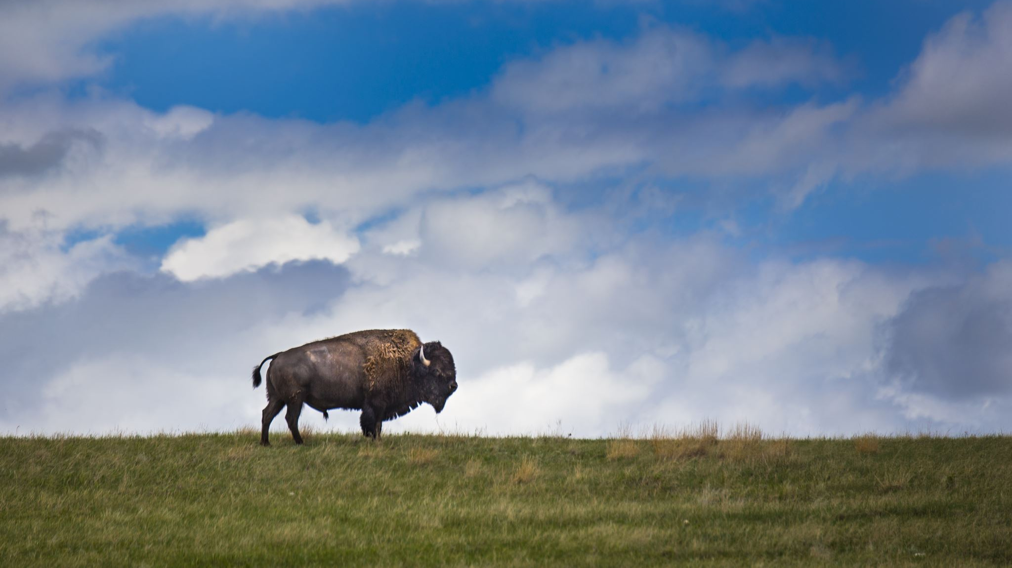
North Dakota Children’s Cabinet Values, Vision & Mission
VALUES:
360 COMMUNICATION: The Children’s Cabinet will engage in open, honest and meaningful communication that leads to positive results for all children and families.
Optimism: The Children’s Cabinet will be solutions-based, adopting a can-do attitude while avoiding the impulse to admire the problem.
Accountability: The Children’s Cabinet accepts clear accountability for leadership and allows all members to know their role and responsibility while sharing a common vision.
Notes:
9:00am-9:20am

Slide 3
North Dakota Children’s Cabinet Values, Vision & Mission
Vision: The North Dakota Children’s Cabinet ensures that all children are prepared and successful, equipped with the skills, knowledge, and resilience to thrive in an ever-changing world.
Mission: The North Dakota Children's Cabinet collaborates to elevate what works and drive towards a seamless network of services and supports that meet the needs of every child and family.
Notes:
9:00am-9:20am

Slide 4
North Dakota Children’s Cabinet Strategic Goals
Goal #1
Strengthen foundational elements of the North Dakota Children’s Cabinet through the development and communication of a strategic plan by Fall 2025.
Goal #2
Define, measure and report out on the status of child well-being in North Dakota by June 2026.
Goal #3
Identify and elevate promising practices to advance a seamless network of services and supports throughout North Dakota by August 2026.
Notes:
9:00am-9:20am

Slide 5
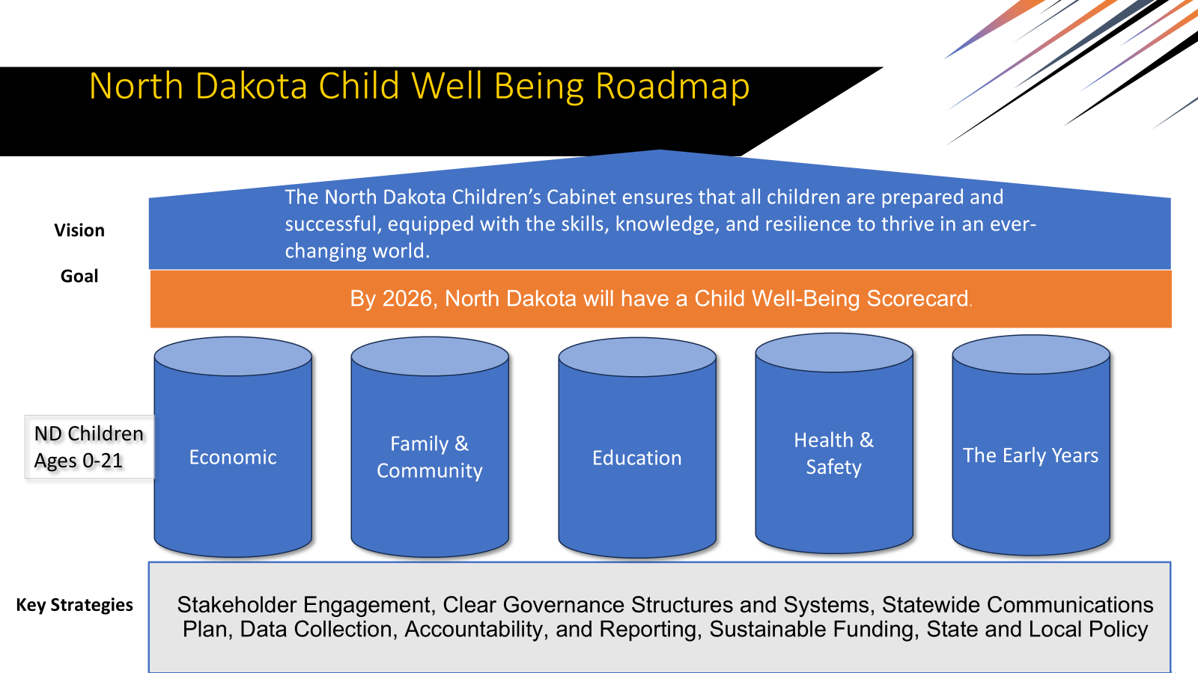
Child Well-Being
Logic Model
Establish Child Well-Being Indicators/Scorecard
Vision: The North Dakota Children’s Cabinet ensures that all children are prepared and successful, equipped with the skills, knowledge, and resilience to thrive in an ever-changing world.
What are our guiding values?
  Transparent & Nimble
  Provide Data-Driven Decision-Making
  Capture all facets of youth development: economic well-being, education, health and safety, and family and community factors.
What scale do we want to measure?
  State Level
Who is our audience?
  Policymakers
  Practitioners
  Public Stakeholders

Slide 6

Education
Child Well-Being
Kindergarten Entry Readiness
3rd Grade Reading Proficiency
Choice-Ready Graduates
Post-Secondary Enrollment

Slide 7
Economic Stability
Child Well-Being
Children Living in Poverty (0-17)
Unemployment Rate of Parents
Homeless Youth
Opportunity Youth

Slide 8
Health & Safety
Child Well-Being
Screen Time
School Discipline
Mental Health
Access to School-based Behavioral Health Services

Slide 9
Family and Community
Child Well-Being
Access to Quality Early Childhood
Chronic Absenteeism
Extracurricular Involvement
Family Economic Stability

Slide 10
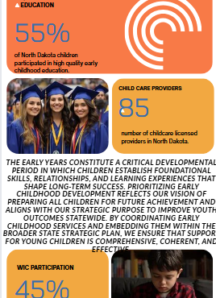
The Early Years
Child Well-Being
Infant Mortality Rate
WIC Participation
Child Care Providers
Quality Early Childhood Education

Slide 11
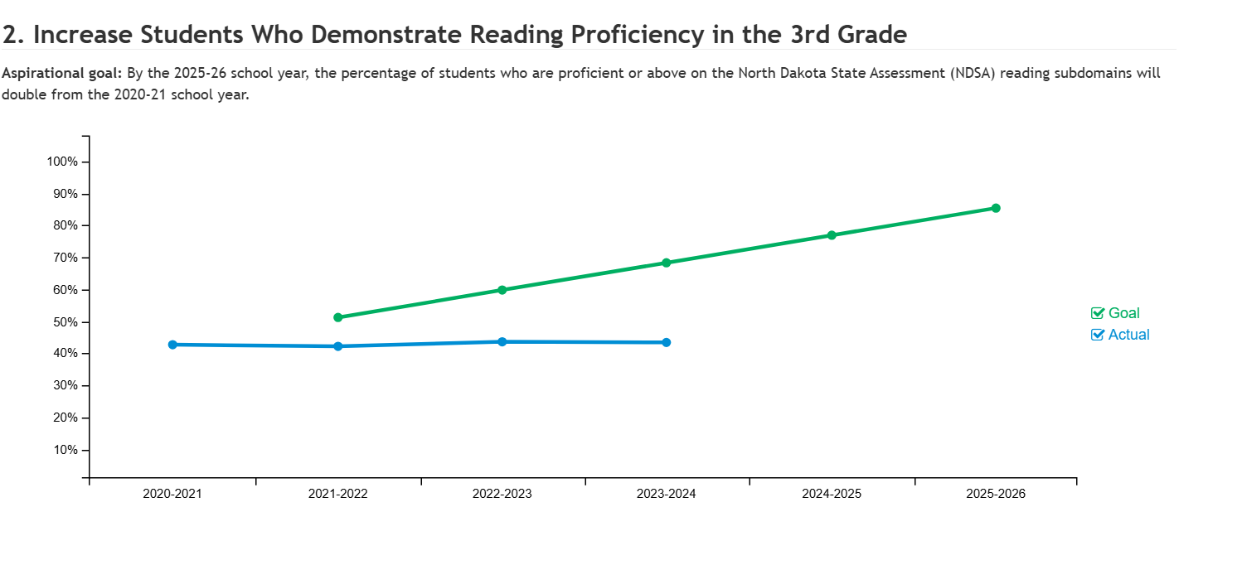
Examples of Scorecards
Notes:
9:00am-9:20am

Slide 12
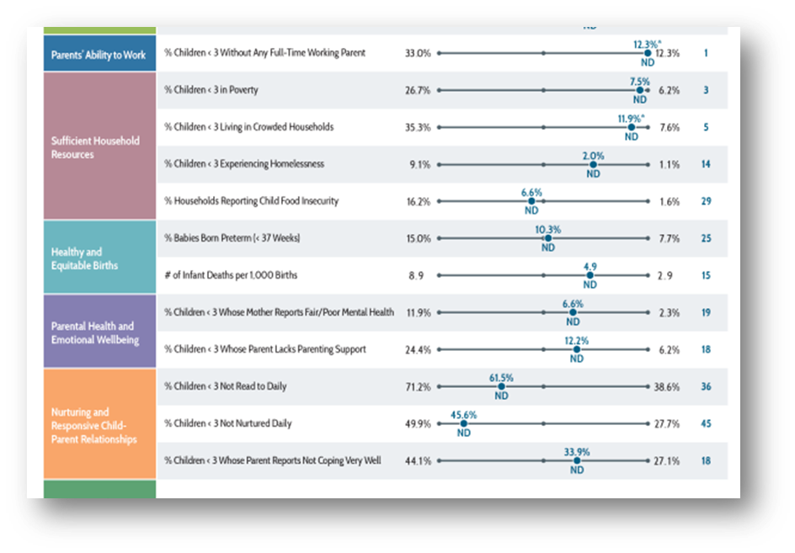
Examples of Scorecards
Notes:
9:00am-9:20am

Slide 13
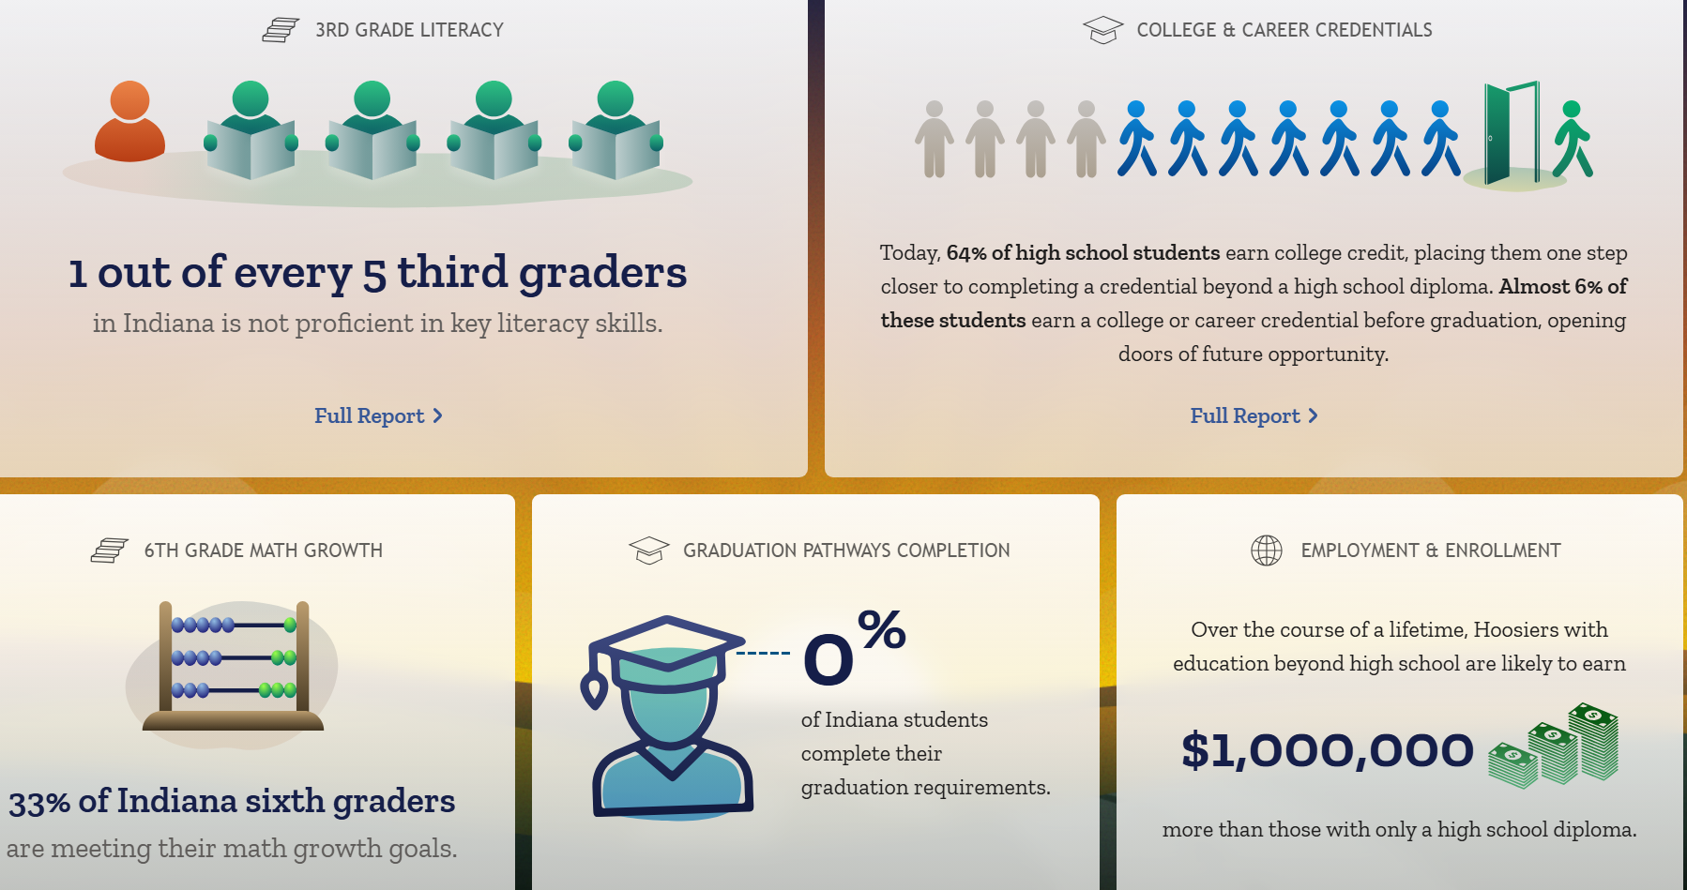
Examples of Scorecards
Notes:
9:00am-9:20am

Slide 14
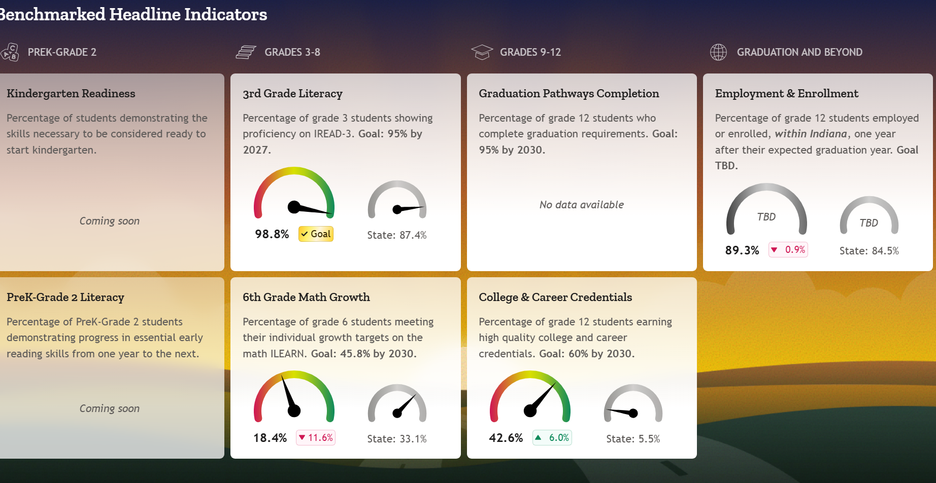
Examples of Scorecards
Notes:
9:00am-9:20am

