Slide 1


Cross Systems Solutions for Children with Significant Behavioral / Psychiatric Needs
Division of Juvenile Services
Senator Kathy Hogan, Subcommittee Chair
September 5, 2025
Colby Braun, Director

Slide 2
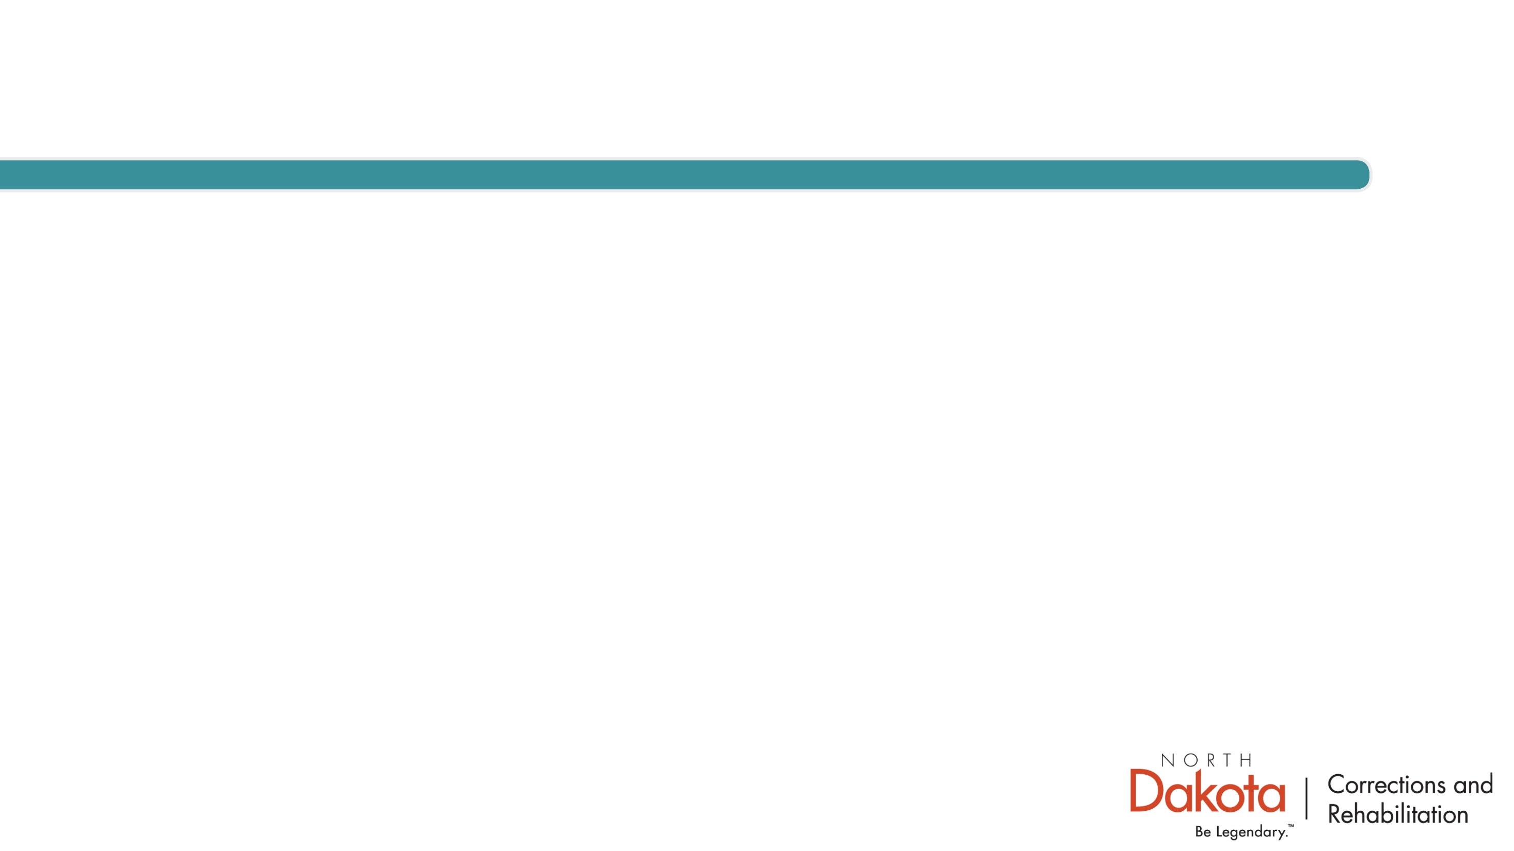
Overview
  DJS supervises ~100 youth daily
  Youth Correctional Center (YCC) capacity: 35
  Out of ~ 60,000 ND youth over age 12
  Population = small, but very high-risk
Notes:
The DJS serves a very specific, very small, but very high-risk population of youth in our state. On any given day, about 100 youth are under our supervision, and our secure facility — the Youth Correctional Center — has a capacity of 35. To put that into perspective, that’s out of roughly 60,000 youth over age 12 enrolled in our public schools.
The courts reserve DJS custody for youth who present the highest risk to public safety. Our responsibility is to balance the safety of the community with the treatment and rehabilitation needs of these young people.

Slide 3
Roles and Responsibilities
    Custody by district court order
    Diagnostic evaluation → treatment & rehab plan
    Written plan due to court in 10 days; progress report every 90 days
    Placement decisions based on youth needs & available services
    Authority to use YCC for high-risk youth (court approval required)
Notes:
Statutory Mandate:
DJS takes custody of delinquent youth by court order.
Required to process each youth through diagnostic evaluation to determine treatment and rehabilitation in the best interest of the youth and the state.
Develops a written treatment and rehabilitation plan, submitted to the court within 10 days of evaluation, with progress reports every 90 days.
Placement Authority:
Placement decisions are made based on youth needs and service availability.
Youth who pose an immediate threat to public safety may be placed at the Youth Correctional Center (secure facility).
DJS has emergency authority to act, but all placements are subject to court approval and post-placement administrative hearings.

Slide 4
Assessment Tools
    Youth COMPAS = primary tool (risk/needs typologies)
    Other tools: violence predictor, home eval, specialized assessments
    2024 data:
      70% = high criminal risk
      20% = mental health/trauma-driven behavior
      10% = “normal” delinquency
      90% = moderate or high risk for further crime
Notes:
What is your definition of children with significant behavioral/psychiatric needs?
In evaluating individual youth, the DJS relies heavily on a normed and validated risk and needs assessment instrument, the Youth COMPAS. Other instruments including a violence predictor tool, a home evaluation, specialized evaluations if necessary, and collection of background information are considered in making the initial placement decision. Decisions are made by a team, although each case is assigned to a specific youth corrections officer for ongoing case supervision.
COMPAS divides youth into typologies, which helps guide the planning process. In 2024, 70% of the youth committed to DJS custody fell into criminal risk typologies, which puts them in the categories of either having committed or are likely to commit serious and violent crime.
20% fell into typologies that indicate their behavior is driven by their unresolved mental health issues or have a primary history of abuse and neglect (which may indicate their behavior is largely driven by a trauma).
The remaining 10% fit typologies of “normal” delinquency, which often abates with development, proper supervision and support.
Youth with significant needs may sometimes demonstrate high-risk behaviors. However, behaviors that originate from a root cause of trauma, poor mental health, substance dependence or situational delinquency are NOT the same as behaviors driven by antisocial beliefs, attitudes and cognitions. The DJS believes it is important to distinguish between these two primary drivers.

Slide 5
Nature of Cases
    Most youth adjudicated for:
      Weapon offenses
      Robbery
      Assault, including sexual assault
      Drug offenses
Notes:
Furthermore, COMPAS assessed 90% of the youth as moderate or high risk for further criminal activity, with only 10% ranked as low risk for further crime. To help you think about the term “crime”, most of the youth committed to DJS have committed a crime with a weapon, robbery, assault including sexual assault, and drug offenses.

Slide 6
Strengths of DJS
    Accurate risk/needs assessment → reliable case planning
    Strong behavior management system at YCC
      De-escalation as first response
      Staff trained in safe physical interventions
    Evidence-based interventions:
      Cognitive-behavioral approaches
      Focus = risk reduction, not just containment
Notes:
2. Within your system, what are the strengths of your continuum of care across systems and what specific services are provided?
Strong Case Intake & Planning:
DJS has refined the initial case intake process over time and is able to identify a youth’s risks and needs accurately and reliably. This provides a stable foundation for case planning, and this is a strength that supports officer judgement and protects community safety..
Behavior Management at YCC:
The Youth Correctional Center utilizes an effective behavior management system that de-escalates most situations and trains regularly the physical intervention techniques that allow for the safe management of youth when de-escalation is not effective.
Use of Evidence-Based Interventions:
Heavy reliance on cognitive-behavioral interventions for youth with entrenched antisocial thinking and violent behaviors.
Goal is not just containment, but actual risk reduction

Slide 7
Challenges and Gaps
    No residential treatment in ND for youth with problematic sexual behaviors
    Limited QRTP & PRTF capacity → struggle with high-behavior youth
    Services designed primarily for high-criminal-risk youth
    Not well-suited for 20% driven by trauma, mental health, or substance use
Notes:
As you can see, this population is very small but requires intensive and focused risk reduction strategies and interventions, and careful supervision.
Challenges and Gaps in Services
Lack of Specialized Residential Options:
No residential treatment available in North Dakota for youth with problematic sexual behaviors.
Limited both QRTP (Qualified Residential Treatment Programs) and PRTF (Psychiatric Residential Treatment Facility) Capacity:
Existing residential programs struggle to manage youth whose behaviors escalate beyond their capacity for safe management.
Mismatch for Certain Typologies:
About 20% of youth in our custody have behaviors driven more by mental health, trauma, or substance use than by antisocial risk factors.
Current interventions are not well-designed for this group, and they often struggle in settings built primarily for high-criminal-risk youth.
.

Slide 8
Juvenile Services
  Challenges and Gaps
  No residential treatment in ND for youth with problematic sexual behaviors
  Limited QRTP & PRTF capacity → struggle with high-behavior youth
  Services designed primarily for high-criminal-risk youth
  Not well-suited for 20% driven by trauma, mental health, or substance use
Notes:
The key areas of the DOCR budget is first and foremost safety. If we aren't safe nothing else really matters, because then that is all we are doing is focusing on becoming safe.
The main topics of the discussion today will be these main areas:
We are a people facing agency, so team members is our long-term and major budget expense.

Slide 9
Success Defined
    Dual system of care:
      Effective risk-reduction for serious, violent youth
      Specialized services for youth driven by trauma, MH, SUD
    Critical to distinguish risk-driven vs. need-driven behavior
    Success = protecting public safety and addressing root causes
Notes:
“SUCCESS” for the endeavor today, from the perspective of the DJS, would be the development of a system of care, community based and residential, that could address the needs of that 20% of youth whose behaviors are extreme but who are primarily driven by their needs and not by criminal risks.
Distinction Matters:
It is critical to distinguish between youth whose behaviors are driven by antisocial beliefs and attitudes versus those whose behaviors stem from trauma or psychiatric needs.
The strategies to reduce risk are not the same, and the services cannot be identical.
Bottom Line:
Success would mean a system where North Dakota can deliver intensive, focused risk reduction for the truly high-criminal-risk youth and build a continuum that adequately serves youth whose extreme behaviors are rooted in treatable needs rather than criminal risk.

Slide 10
Closing
    DJS = protects community & rehabilitates high-risk youth
    Strengths: accurate assessment, case planning, behavior management
    Challenges: lack of specialized treatment & limited residential capacity
    Success = comprehensive system of care for both risk- and need-driven youth
Notes:
DJS is tasked with protecting public safety while rehabilitating the state’s highest-risk youth.
Our strengths lie in accurate assessment, effective case planning, and evidence-based risk reduction strategies.
But our greatest challenge is the lack of specialized treatment options for youth whose behaviors are need-driven rather than risk-driven.
Success, from our perspective, is a system of care that meets both needs: protecting the community while addressing trauma, mental health, and substance use at their roots.

