Slide 1
Federal Requirements
IDEA guarantees every student with a disability the right to a Free Appropriate Public Education (FAPE)—even when behavioral challenges arise.
Schools must continue services during disciplinary actions and address behavior through the IEP process.
Maintaining a safe and orderly campus is a parallel responsibility, requiring fair, evidence-based discipline.
These dual obligations demand inclusive, legally sound practices that protect both student rights and school safety.

Slide 2

What is your definition of children with significant behavioral/psychiatric needs?

Slide 3
Strengths
Dedicated educators & administrators
State funding for high-cost students
Beginning collaboration with other state & local agencies
Guidelines for IDEA eligibility categories
Evidence based practices trainings to increase student engagement

Slide 4
Challenges of your continuum of care across systems and where are the gaps in services
Need for full day specialized classrooms for behavioral health (especially in rural areas)
A visual of how DHHS continuum of care and IDEA least restrictive environment intertwine.
Space for school personnel and DHHS staff to brainstorm around particular students
Shortages and turn over of school based and community providers
Comprehensive evaluations for students
  Get to root cause

Slide 5
Challenges, Cont.
Administrators’ understanding IDEA, Section 504, NDCC
Access to teachers for training
Transportation
Ability to fund behavioral specialists or coaches to support schools
Transition to and from residential or treatment programs
Medicaid
Integrated MTSS – earlier identification of needs
Presuming Competence and giving students a clean slate
Focusing on prevention versus intervention

Slide 6
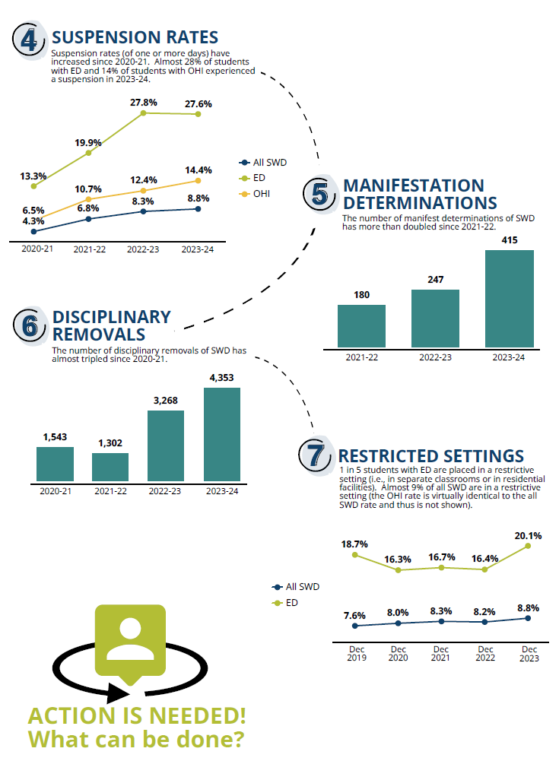
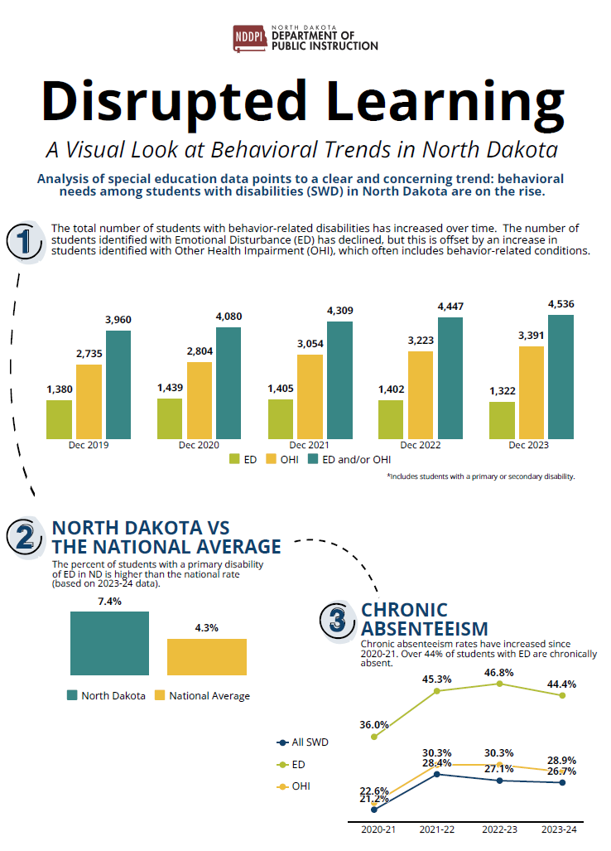

Slide 7
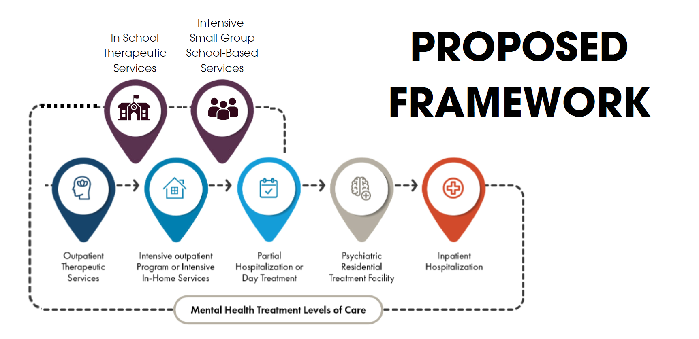
What Does Success Look Like?

