Slide 1

Child Care Presentation – Governor’s Children’s Cabinet
Early Childhood Subcommittee
Introduction
  Amy Cleary, GA Group, PC, www.gagroup.law
    acleary@gagroup.law
    701-595-2317
Our Role
  Work since 2022 with South East Education Cooperative, YMCA Alliance of ND, & others
  Invited to share a third-party perspective on child care advocacy
Resources
  2022 SEEC-commissioned Interview Project – Report & Executive Summary
  2024 SEEC-commissioned assessment & survey analysis – Report & Executive Summary
  Download here: https://www.gagroup.law/post/ga-group-2022-2024-child-care-reports

Slide 2
2022: Childcare Interviews & Insights
Childcare as Workforce Issue
Emerged as one of ND’s biggest workforce challenges
Framed around Availability, Affordability, Quality
Reports (Hunt Institute, ND Kids Count) + signals from Governor Burgum & DHS
SEEC Interviews (35+)
Leaders from child care, education, business, government
Goal: listen & capture full picture of family, provider, and community needs
Key Findings = NEEDS:
Availability: 10,000 slots + 1,400 workers needed; avg. wage ~$11/hour
  Solutions: wage supports, CTE pathways, scholarships, business incentives
Affordability: Families spending ~30% of income (vs. 7% benchmark)
  Ideas: expand CCAP, extend provider stabilization grants, tuition help for workers, benefits pools, infrastructure dollars
Quality: Need for business support, professionalization & administrative supports
  Ideas: strengthen QRIS, mentorship/shared services, faster fingerprinting, clearer licensing & reimbursement, career pathways

Slide 3
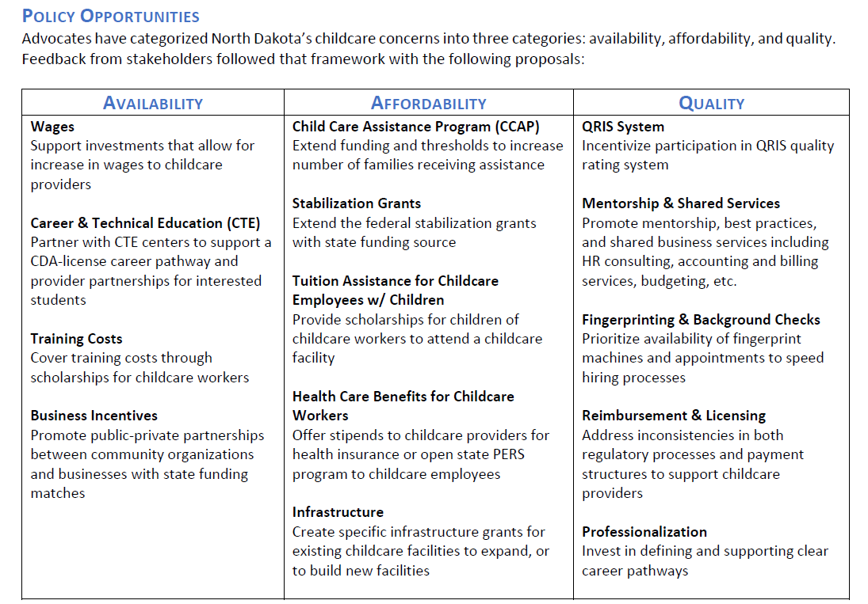
2022 Executive Summary: Policy Opportunities
✓
✓
✓
✓
✓
✓
✓
✓

Slide 4
2023:
Session Advocacy & HB 1540
Shaping the Session
Governor’s Office & DHS led charge to tackle childcare challenges
Advocacy focus: make childcare part of workforce discussion
  Highlighted family costs & CCAP expansion
  Raised concern over end of provider stabilization grants (“the cliff”)
HB 1540: Addressed 8+ Recommendations
Availability
  Training grants for workers
  Business incentives (WPCCR/3-way cost sharing)
  Infrastructure: new slots & facilities
Affordability
  Expanded CCAP support
  Worker benefit: coverage for own kids
Quality
  QRIS incentives
  Shared services (streamlined operations)
  Faster fingerprinting & background checks
Bottom line: Recognizing problems → Funding solutions

Slide 5
2024:
Mid-Biennium Assessment
Big Picture
Major funding package in motion (focus on ages 0–3) → huge win
SEEC asked GA Group to:
  1) Review HB 1540 impacts + other agency funding
  2) Collect reports and survey data for additional community insights
1) State Investment Analysis
HB 1540 Snapshot (Aug 2024)
  Pros: CCAP heavily used; worker co-pay waiver
  Cons: Some programs underspent (quality, WPCCR) → signals for adjustments
Other Agencies: Nearly $20M infrastructure investment outside HB 1540
  RWIP (Commerce): $13.3M (~50% of $26.5M) in childcare grants for infrastructure, 2,344 projected new slots (53 facilities)
  ND Development Fund: $7M loans → 20 projects, +1,000 slots

Slide 6
2024:
Survey Analysis
  2) Community Input Survey Insights (5 Surveys):
  DHHS Market Study (NDSU)
  Chamber & EDC survey (SEEC)
  School personnel survey (SEEC)
  Bismarck-Mandan parent survey (EDC Leadership Cohort)
  Greater North Dakota Chamber (GNDC) member survey
  Top Takeaways
  Families
    Affordability & availability remain top challenges
    Infant care scarce & costly
  Providers
    CCAP helps, but reimbursements don’t cover costs
    Hiring continues to be difficult
  Schools
    Strong interest in out-of-school time care (ages 6–12)
    Funding & staffing barriers
  Businesses
    Recognize childcare as a workforce barrier
    Many unaware of state programs or how to engage

Slide 7
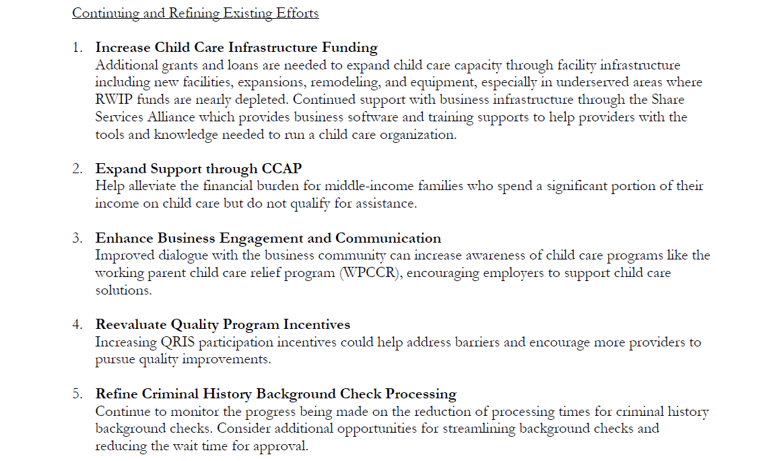
2024 Executive Summary: Policy Opportunitiesy Opportunities

Slide 8
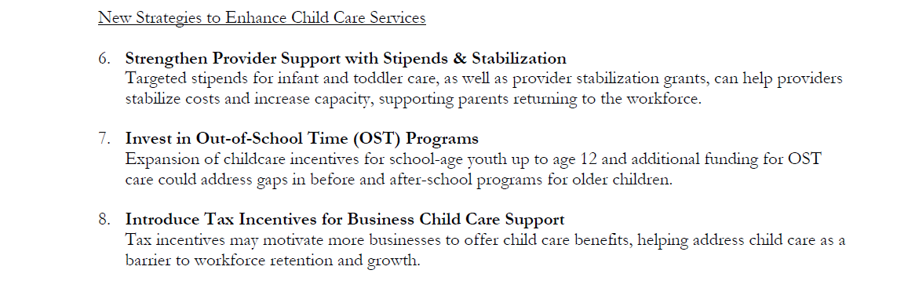
2024 Executive Summary: Policy Opportunities, Cont.y Opportunities
✓
✓

Slide 9
2025: Session Advocacy & Outcomes
Advocated For:
Sustain CCAP – Sustain & expand funding to lower family costs
Fund Infrastructure – More state support through DHHS (beyond RWIP)
Support Providers – Direct stabilization funds to support wages & capacity
Engage Businesses Better – Adjust WPCCR to be workable, or create tax incentives
What Happened:
Strong funding continues; DHHS push for continuity, advocates echoed
Only $1M in DHHS budget; Commerce excluded childcare from $5M RWIP
$11M infant/toddler provider program approved (Cleary & Davison) – first step forward
WPCCR uptake remained low; $2.2M retained
SB 2282 passed → tax credit (50% of contributions, up to $1,000/employee)

Slide 10
Legislative Attitudes: 2023–2025
2023: Momentum
  Gov. Burgum & early champions → framed childcare as workforce issue
  Pushback from traditional conservatives
  Ultimate message: ND’s economy can’t afford one-parent households
2025: Polarized
  Legislators asking: “What’s all this funding gotten us?”
  Champions quieter; stand-alone bills failed, pushed into DHHS budget
  Support shaped by personal experience vs. workforce-related data
Key Dynamics
  Legislature still largely older & male, but see younger generations
  Gaps persist: school-age care, provider wages, family costs, background check delays
  Lawmakers want more data to validate anecdotes and justify increased funding
Push & Pull
  New champions emerging; others retreating
  Reallocation over expansion – don’t “add” dollars
  Childcare policy caught between urgency & hesitation

Slide 11
Looking Ahead: 2027 Advocacy & Beyond
Refinement of Programs
  Ensure childcare programs are accessible, effective, and sustainable
  Stay flexible with adjustments and reallocations as needs change
  Gaps still remain: Out-of-school (OST) time funding, provider stabilization, staffing challenges, business incentives
Advocacy & Voice
  Ongoing challenge: limited unified voice(s) for child care providers
  Chambers and business leaders have helped fill the gap, but stronger coordination is needed
Accountability & Results
  Lawmakers want to see tangible outcomes from investments – more education needed
Partnership & Leadership
  Recognize and continue engaging business and community leaders who elevate childcare as a workforce issue

