Slide 1
North Dakota
Child Well-Being
Indicators
North Dakota Children’s Cabinet
February 4, 2026

Slide 2

North Dakota Children’s Cabinet Values, Vision & Mission
VALUES:
360 COMMUNICATION: The Children’s Cabinet will engage in open, honest and meaningful communication that leads to positive results for all children and families.
Optimism: The Children’s Cabinet will be solutions-based, adopting a can-do attitude while avoiding the impulse to admire the problem.
Accountability: The Children’s Cabinet accepts clear accountability for leadership and allows all members to know their role and responsibility while sharing a common vision.
Notes:
9:00am-9:20am

Slide 3
North Dakota Children’s Cabinet Values, Vision & Mission
Vision: The North Dakota Children’s Cabinet ensures that all children are prepared and successful, equipped with the skills, knowledge, and resilience to thrive in an ever-changing world.
Mission: The North Dakota Children's Cabinet collaborates to elevate what works and drive towards a seamless network of services and supports that meet the needs of every child and family.
Notes:
9:00am-9:20am

Slide 4
North Dakota Children’s Cabinet Strategic Goals
Goal #1
Strengthen foundational elements of the North Dakota Children’s Cabinet through the development and communication of a strategic plan by Fall 2025.
Goal #2
Define, measure and report out on the status of child well-being in North Dakota by June 2026.
Goal #3
Identify and elevate promising practices to advance a seamless network of services and supports throughout North Dakota by August 2026.
Notes:
9:00am-9:20am

Slide 5
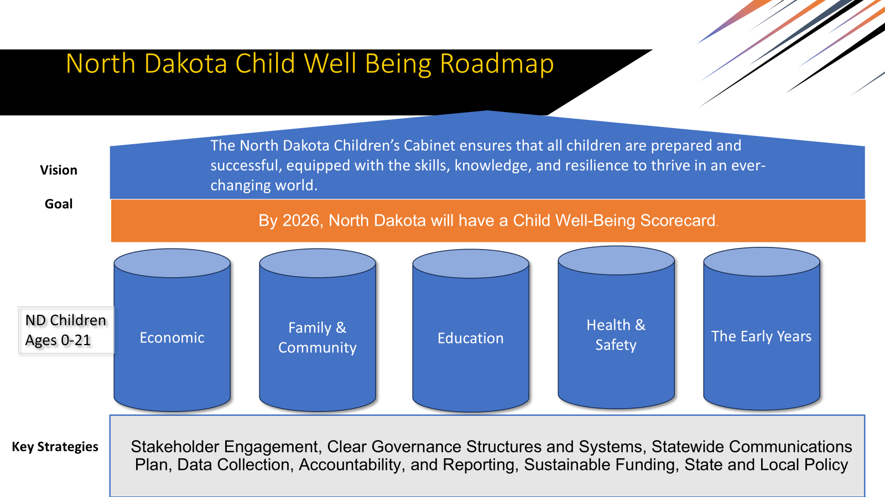
Child Well-Being
Logic Model
Establish Child Well-Being Indicators/Scorecard
Vision: The North Dakota Children’s Cabinet ensures that all children are prepared and successful, equipped with the skills, knowledge, and resilience to thrive in an ever-changing world.
What are our guiding values?
  Transparent & Nimble
  Provide Data-Driven Decision-Making
  Capture all facets of youth development: economic well-being, education, health and safety, and family and community factors.
What scale do we want to measure?
  State Level
Who is our audience?
  Policymakers
  Practitioners
  Public Stakeholders

Slide 6
NORTH Dakota Child Well-being
When you consider the North Dakota Children’s Cabinet’s vision of “…all children are prepared and successful, equipped with the skills, knowledge, and resilience to thrive in an ever-changing world.”, which of these indicators would help inform what is “thriving”?
Which factors most influence whether children thrive or struggle?
How do you envision a child well-being scorecard being used (policy, practices, funding, accountability, public transparency)?
How do we ensure we inform audience on all youth?

Slide 7
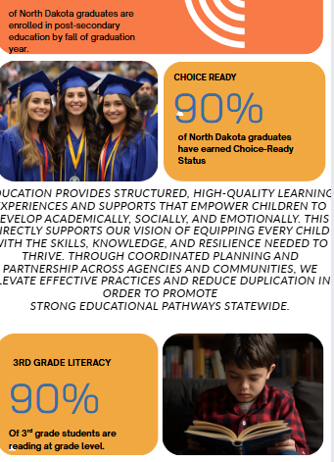
Education
Child Well-Being
Kindergarten Readiness
3rd Grade Literacy
Choice Ready Graduates
Post-Secondary Enrollment
Employment Indicator
Enlistment Indicator

Slide 8
Education
Current
Kindergarten Readiness
3rd Grade Literacy
Choice Ready Graduates
Post-Secondary Enrollment
Employment Indicator
Enlistment Indicator
Additional Indicators
Chronic Absenteeism
PreK-Grade 2 Literacy
6th Grade Math
Advanced Coursework prior to 9th Grade
FAFSA Completion Rate
Credentials of Value

Slide 9
Economic Stability
Child Well-Being
Children Living in Poverty (0-17)
Homeless Youth
Opportunity Youth

Slide 10
Economic Stability
Current
Children Living in Poverty (0-17)
Homeless Youth
Opportunity Youth
Additional Indicators
Economic assistance data sets within Targeted Population groups: SNAP, MA, WIC, LIHEAP, TANF, CCAP
Labor Force Data

Slide 11
Health & Safety
Child Well-Being
Screen Time Usage
School Discipline
Mental Health
Access to School-based Behavioral Health Services
Youth Substance Abuse
Youth with Complex Needs

Slide 12
Health & Safety
Current
Screen Time Usage
School Discipline
Mental Health
Access to School-based Behavioral Health Services
Youth Substance Abuse
Youth with Complex Needs
Additional Indicators
Families First Data
Confirmed case with safety plans & closed
Mandatory Reporting #’s
ND Child Fatality
Child Obesity
Underweight newborn rates
Juvenile court data

Slide 13
Family and Community
Child Well-Being
Access to Quality Early Childhood
Chronic Absenteeism
School Belonging
Extracurricular Involvement
Family Economic Stability

Slide 14
Family & Community Child Well-Being
Current
Access to Quality Early Childhood
Chronic Absenteeism
School Belonging
Extracurricular Involvement
Family Economic Stability
Additional Indicators
Kinship Data Points
Child Systems Data Points: DD numbers, QRTP, PRTF, TFC,FC, Certified Shelters
CHINS Data
Detention Data
# of youth on probation/juvenile court data
Food Insecurity

Slide 15
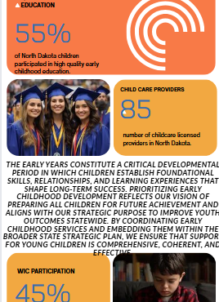
The Early Years
Child Well-Being
Prenatal Care Indicator
Child Care Providers
Quality Early Childhood Education
Access to Early Invention (Age 0-3)

Slide 16
The Early Years
Current
Prenatal Care Indicator
Child Care Providers
Quality Early Childhood Education
Access to Early Invention (Age 0-3)
Additional Indicators
Head Start Data
Confirmed findings data
Foster Care numbers
Kinship numbers for this subset
Infant Development/Early Intervention
CACFP data
Infant Mortality Rate
WIC Participation

Slide 17
North Dakota Child Well-Being Scorecard Design
Transparent & Nimble
Tells a holistic youth development story (education, economic stability, family & community, health & safety, The Early Years).
Covers child/youth development, ages 0-21.
Fosters cross-system alignment.
Drives data decision-making (policy, funding, focus).
Captures all youth.

Slide 18
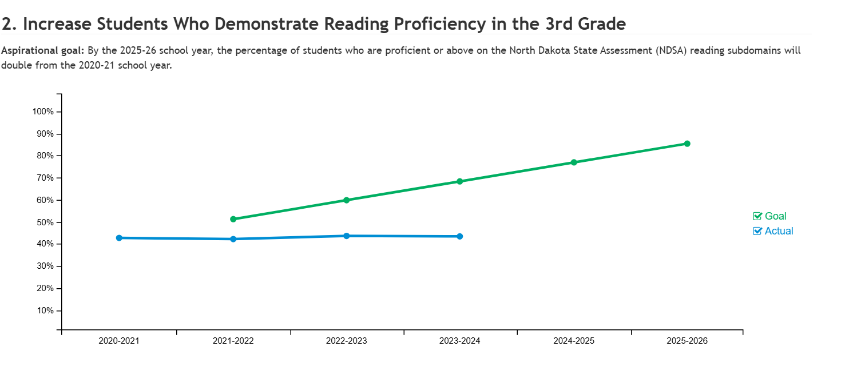
Examples of Scorecards
Notes:
9:00am-9:20am

Slide 19
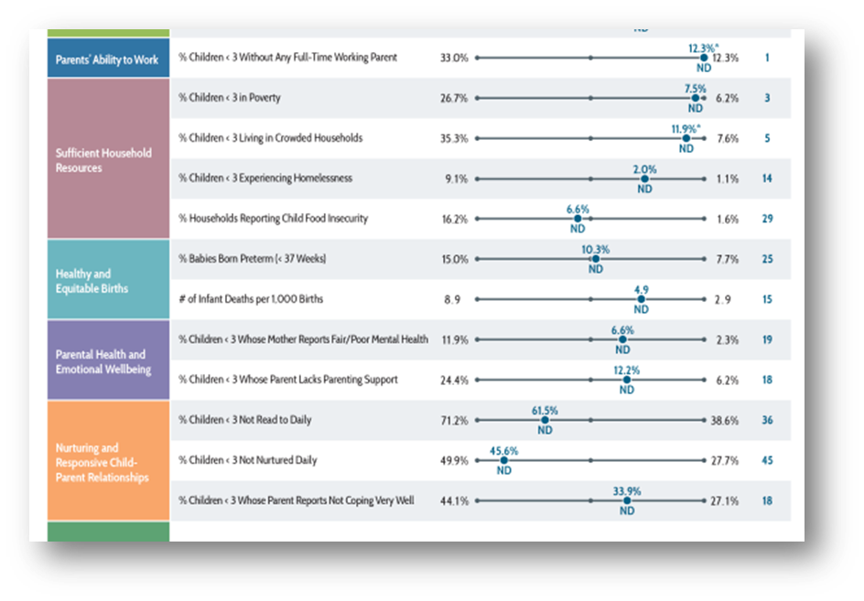
Examples of Scorecards
Notes:
9:00am-9:20am

Slide 20
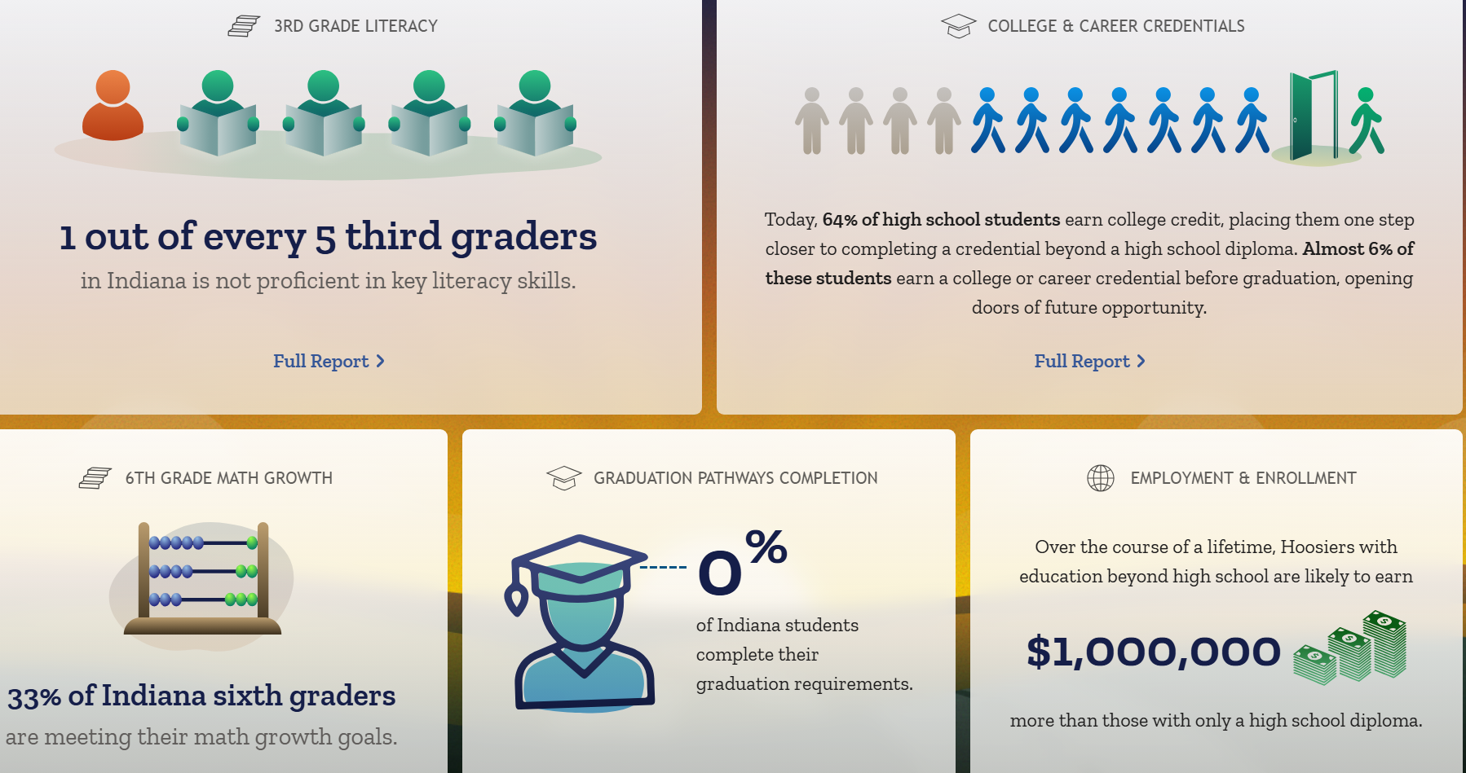
Examples of Scorecards
Notes:
9:00am-9:20am

Slide 21
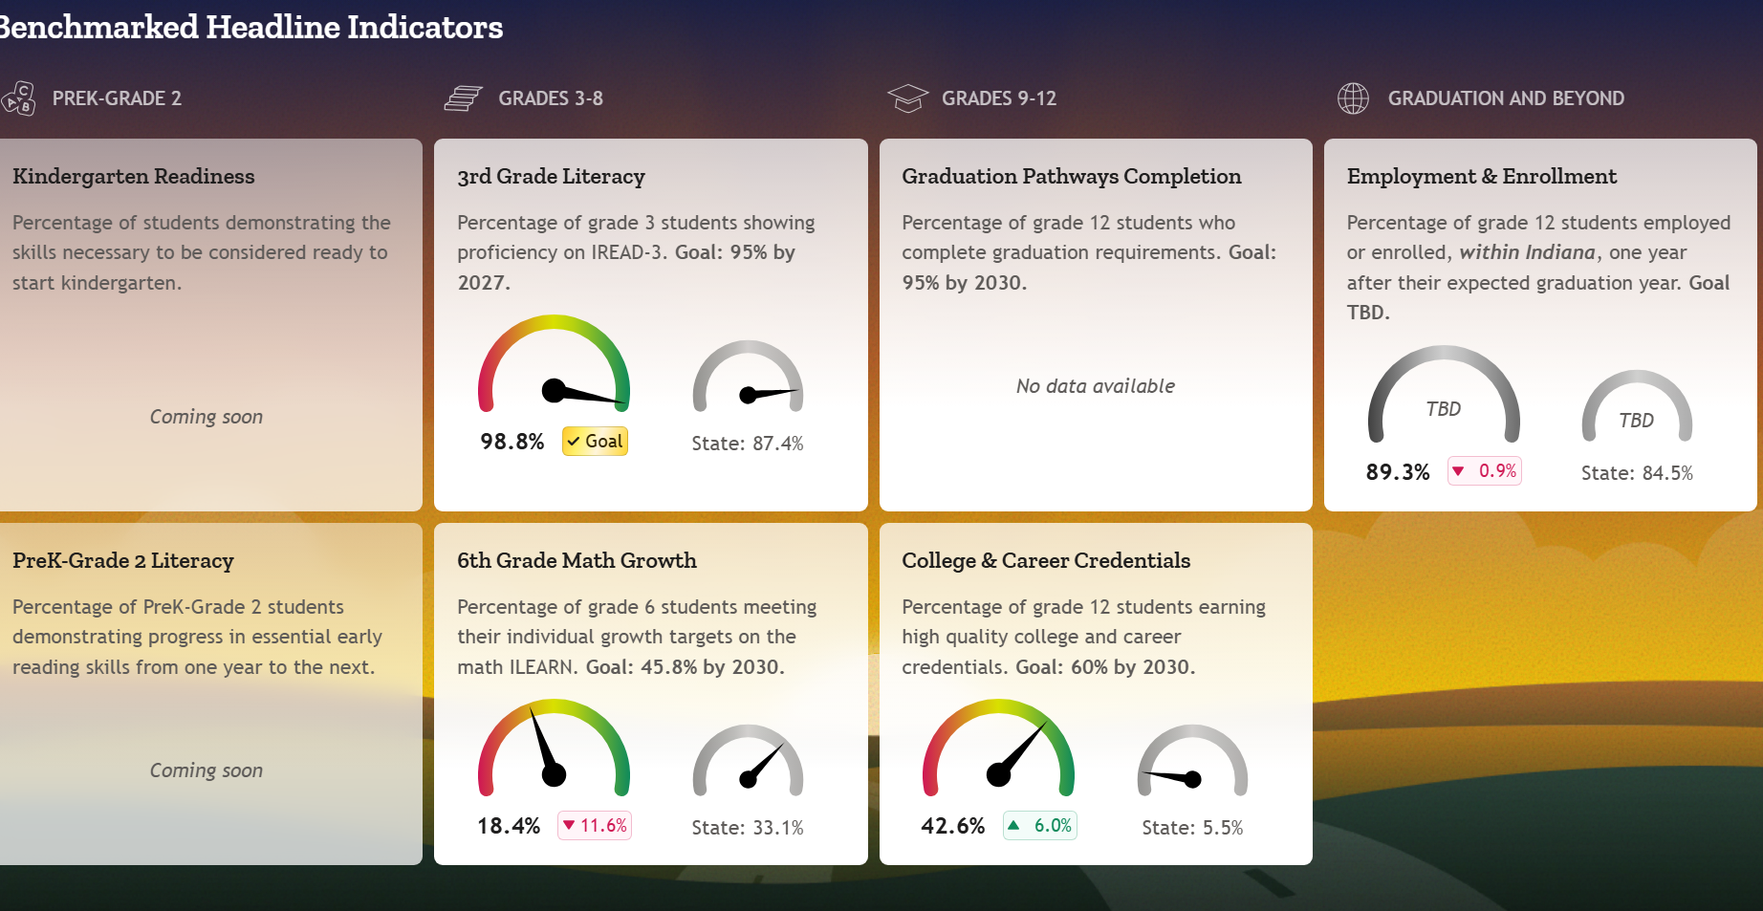
Examples of Scorecards
Notes:
9:00am-9:20am

Slide 22
Contact
Jason Callahan
North Dakota Children’s Cabinet Coordinator
jacallahan@nd.gov

