Slide 1
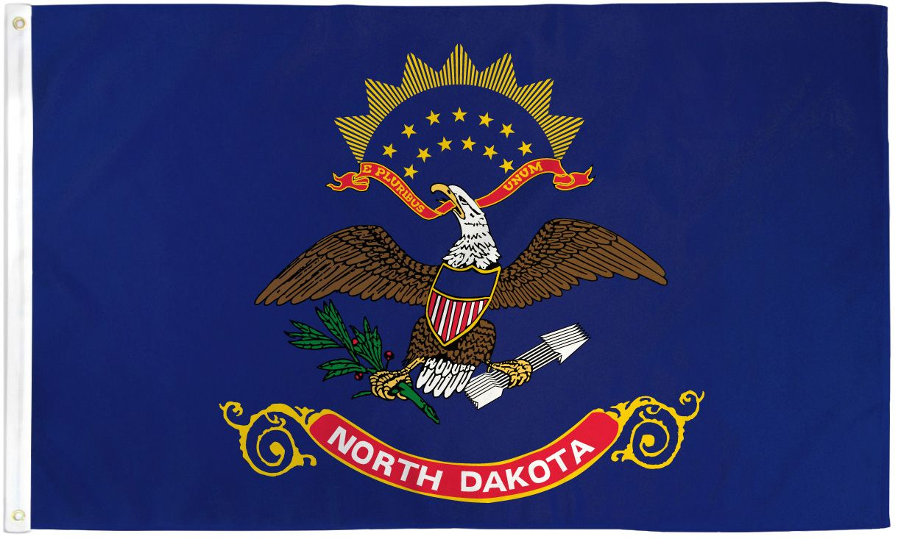
North Dakota Children’s Cabinet Strategic Plan

Slide 2
Overview
Mission, Vision, & Guiding Values
Strategic Goals
Strategic Initiatives
Policy & Legislative
Data & Evaluation
Sustainability
Community Engagement
PWLE Engagement
Programmatic
Tactics
(Distinct actions/activities for Years Two & Three)

Slide 3
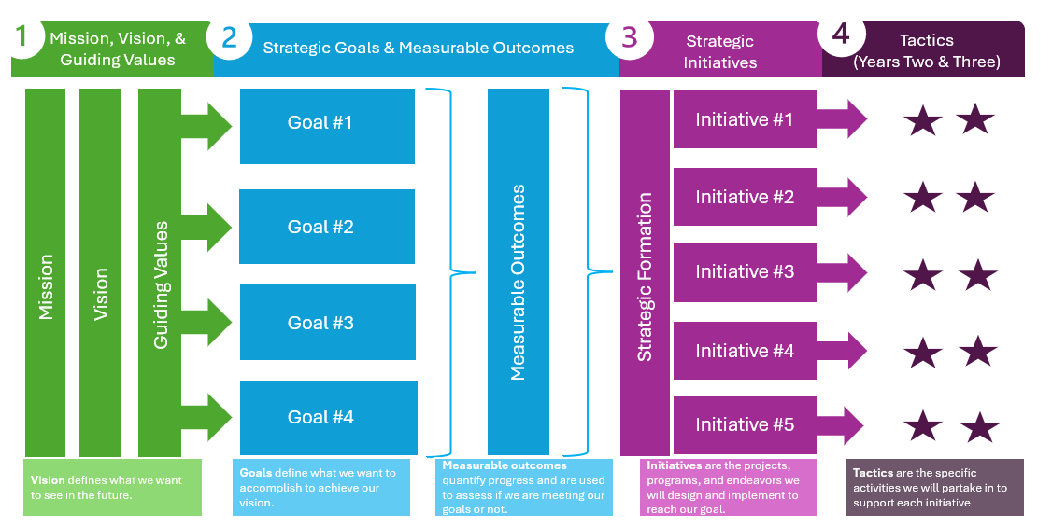
Overview

Slide 4
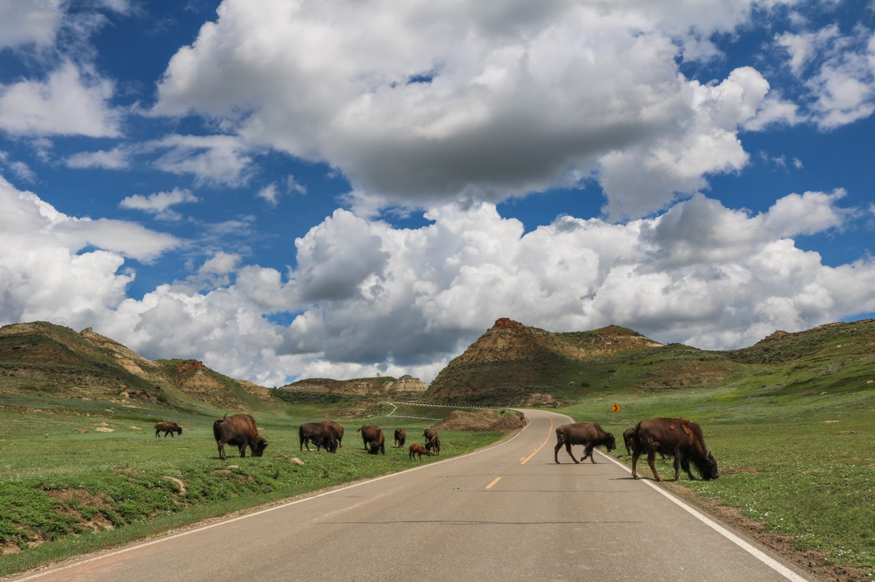
Vision & Guiding Values
Vision: The North Dakota Children’s Cabinet ensures that all children are prepared and successful, equipped with the skills, knowledge, and resilience to thrive in an ever-changing world.
Mission: The North Dakota Children's Cabinet collaborates to elevate what works and drive towards a seamless network of services and supports that meet the needs of every child and family.
Guiding Values:
360 Communication
Optimism
Accountability
Defined focus population: Youth ages birth-21

Slide 5



Impact Statement & Goals
Mission: The North Dakota Children's Cabinet collaborates to elevate what works and drive towards a seamless network of services and supports that meet the needs of every child and family.
.
Goal Statements:
Goal #1: strengthen foundational elements of the North Dakota Children’s Cabinet through the development and communication of a strategic plan by Fall 2025.
Goal #2: Define, measure and report out on the status of child well-being in North Dakota by June 2026.
Goal #3:
Identify and elevate promising practices to advance a seamless network of services and supports throughout North Dakota by August 2026.
Notes:
:

Slide 6
Questions for Goal #2: Child Well-being
How do we define child well-being?
How do we want to organize? Topically? Chronologically? Both?
What metrics exist that we want to include?
What terms do we want to find consensus on?
Guiding Values:
360 Communication
Optimism
Accountability

Slide 7
Planning and Initiation (Sept – Oct 2025) Goal 2.1: By October 2025, Set foundation, finalize project structure, and begin stakeholder identification.
Definition & Stakeholder Engagement (Nov – Jan 2026) Goal 2.2: By January 2026 Build consensus on terminology, definition of well-being, and collect feedback.
Data Mapping & Framework Development (Feb – April 2026) Goal 2.3: By April 2026 Identify key indicators and data sources; refine definition and glossary.
Framework Validation and Metric Selection (May – June 2026)Goal 2.4: By June 2026, validate approach with partners, refine metrics, identify long-term data needs.
Finalization and Launch Preparation (July – Aug 2026) Goal 2.5: By August 2026, Finalize the strategic plan and prepare for public launch and implementation planning.
Goal #2: Define, measure and report out on the status of child well-being in North Dakota by August 2026.
Activity #1
R
A
C
I
Timeline
Activity #2
R
A
C
I
Timeline
Activity #3
R
A
C
I
Timeline
Activity #1
R
A
C
I
Timeline
Activity #2
R
A
C
I
Timeline
Activity #3
R
A
C
I
Timeline
Activity #1
R
A
C
I
Timeline
Activity #2
R
A
C
I
Timeline
Activity #3
R
A
C
I
Timeline
Activity #1
R
A
C
I
Timeline
Activity #2
R
A
C
I
Timeline
Activity #3
R
A
C
I
Timeline
Activity #1
R
A
C
I
Timeline
Activity #2
R
A
C
I
Timeline
Activity #3
R
A
C
I
Timeline
Metrics:
Notes:
Activities:
Define child well-being: what are we measuring against? What is the % change we hope to see.
Develop reporting structure and infrastructure to house and report data

Slide 8
Implementation Timeline: Year 1
Goal | Q1 Jul – Sep 2025 | Q2 Oct – Dec 2025 | Q3 Jan – Mar 2026 | Q4 Apr – Jun 2026
Goal #1:
Goal #2:
Goal #3:
Initiative 1.1
Initiative 1.2
Initiative 1.3
Initiative 1.4
Initiative 2.1
Initiative 2.2
Initiative 2.3
Initiative 2.4
Initiative 3.1
Initiative 3.2
Initiative 3.3
Initiative 3.4

Slide 9
Implementation Timeline: Year 2
Goal | Q1 Jul – Sep 2026 | Q2 Oct – Dec 2026 | Q3 Jan – Mar 2027 | Q4 Apr – Jun 2027
Goal #1:
Goal #2:
Goal #3:
Initiative 2.4
Initiative 3.3
Initiative 3.4

